Slide 1
Quantum Computing
Nihar Shah

Slide 2
Classical Bit vs Quantum Bit
Bits: Fundamental units of information processing (classical/quantum). – Discrete/Digital Model of Quantum Computing.
Physical Realizations: (Anything that can be in two states)
Two Voltage Levels
Lights on or off
Position of Toggle Switches
Six-sided die
Physical Realizations:
Polarization of a Photon
Atomic System: Two states for a Hydrogen Atom
Spin of Electron
Many such different realizations of Qubits may exist like in case of Classical computing. We just don’t know yet which is the best in terms of scaling!!

Slide 3
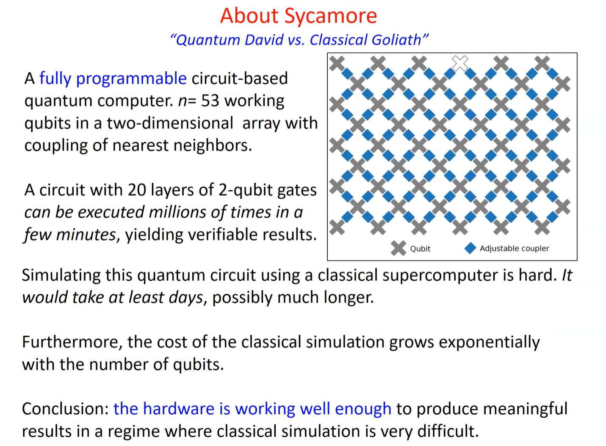

Slide 4
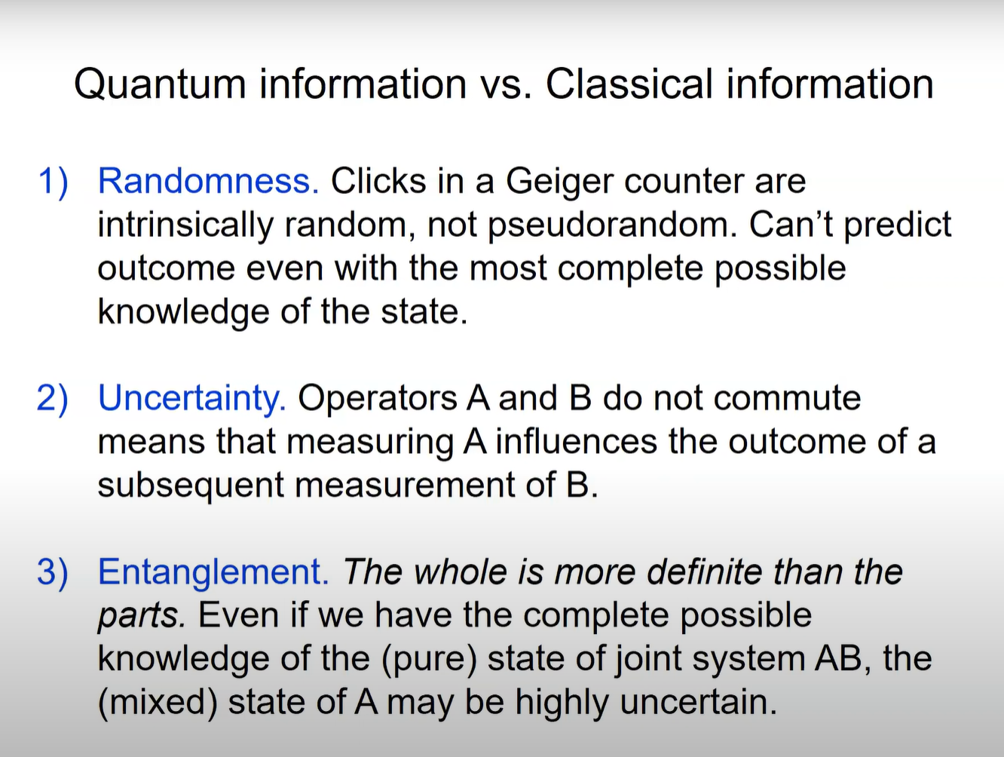

Slide 5
Polarization of a Photon – first implementation by IBM
Polarization of Light
Shine a beam of Light –(a transverse EM Wave) on a projection screen.(Direction of propagation of EM oscillate in plane perpendicular to the direction of propagation.)
Step 1: When Polaroid A is placed between the light source and the screen, the intensity of the light reaching the screen is reduced. Suppose polarization of polaroid A is horizontal.

Slide 6
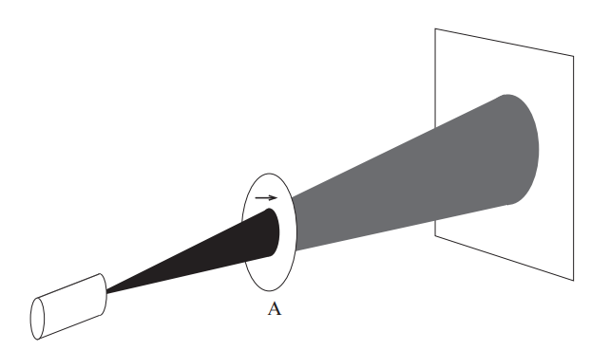
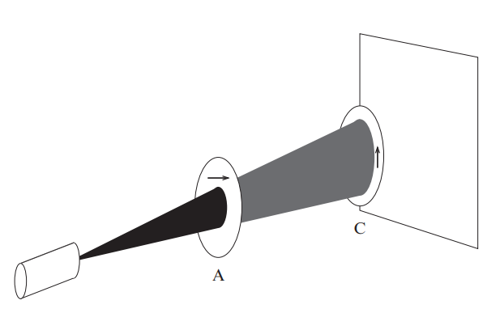
Step 2: Place Polaroid C between Polaroid A and the projection screen. If polaroid C is rotated so that its polarization is orthogonal (vertical) to the polarization of A, no light reaches the screen.

Slide 7
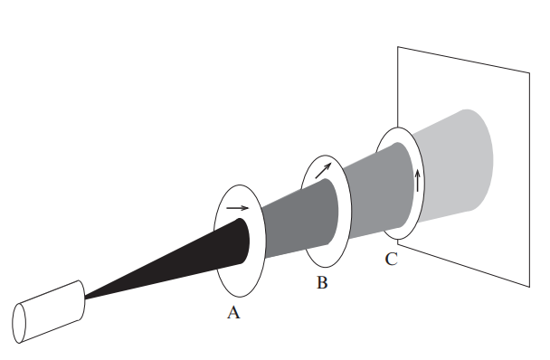
Step 3: Place Polaroid B between polaroids A and C.
Adding another polaroid should not make any difference, since no light goes through two polaroids then no light should pass through three. At most polarization angles of B light shines on the screen (except for orthogonal to A). The intneisty of light will be maximal if the polarization of B is at 45 degrees to both A and C.

Slide 8
A Quantum Explanation
Classical explanation in terms of waves for a bright beam of light.
Assume: only one photon at a time.
Photon’s Polarization State
Interaction of a Polaroid and a photon.
Since light is traversing in a certain direction the Electric and Magnetic fields must be perpendicular to the direction of propagation of light. Thus, the polarization vector is in the plane perpendicular to the direction of propagation of light.
Assumed: Basic Knowledge of Linear Algebra, so we take Linear Algebra and Postulates together.

Slide 9
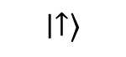
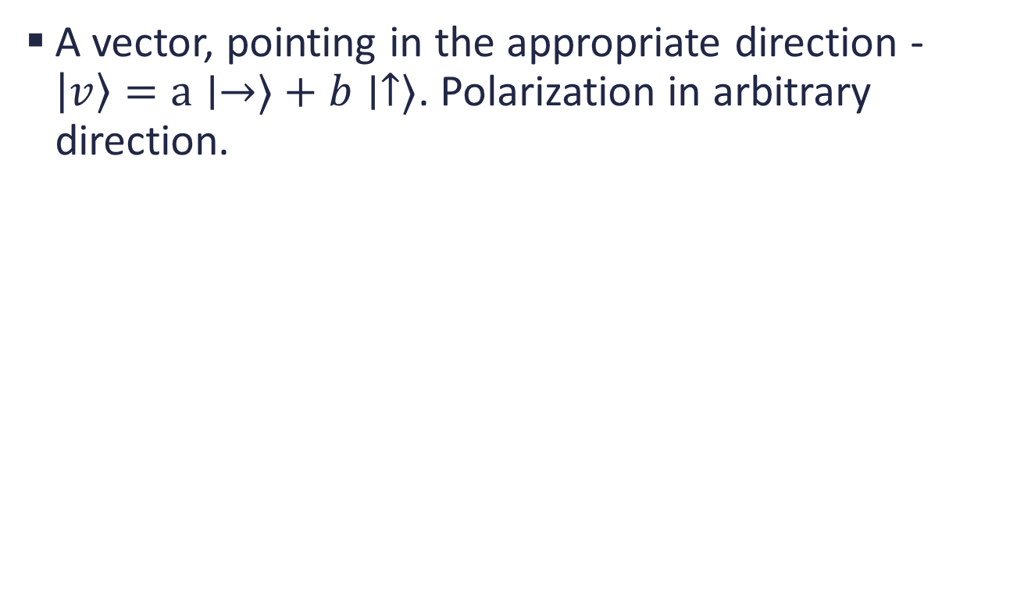
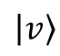
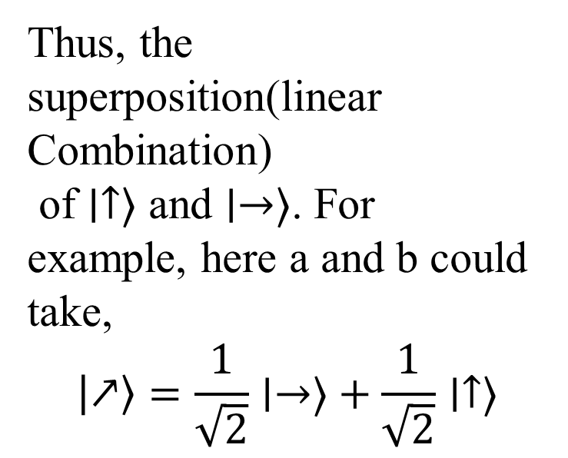
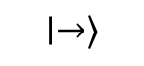
Photon’s Polarization State
A vector, pointing in the appropriate direction - $\left|v\right\rangle =a∣→⟩+b∣↑⟩$. Polarization in arbitrary direction.
Thus, the superposition(linear Combination)
of $∣↑⟩$ and $∣→⟩$. For example, here a and b could take,
$$\left|↗\right\rangle =\frac{1}{\sqrt{2}}∣→⟩+\frac{1}{\sqrt{2}}∣↑⟩$$
$$∣↑⟩$$
$$\left|v\right\rangle$$
Direction of propagation of light
$$∣→⟩$$

Slide 10
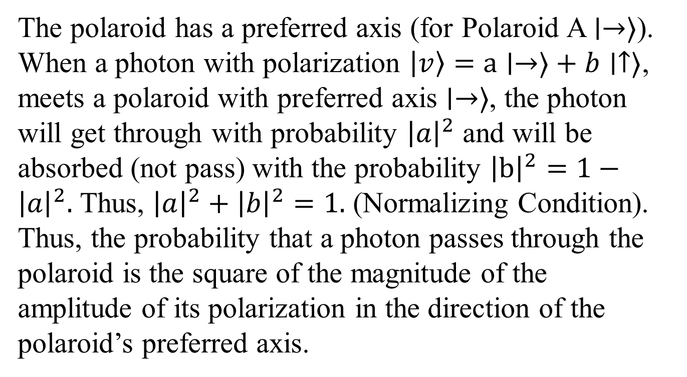
Interaction of Polaroid and a Photon
The polaroid has a preferred axis (for Polaroid A$∣→⟩$).
When a photon with polarization $\left|v\right\rangle =a∣→⟩+b∣↑⟩$, meets a polaroid with preferred axis $∣→⟩$, the photon will get through with probability ${\left|a\right|}^{2}$ and will be absorbed (not pass) with the probability ${\left|b\right|}^{2}=1−{\left|a\right|}^{2}.$ Thus, ${\left|a\right|}^{2}+{\left|b\right|}^{2}=1.$ (Normalizing Condition).
Thus, the probability that a photon passes through the polaroid is the square of the magnitude of the amplitude of its polarization in the direction of the polaroid’s preferred axis.

Slide 11
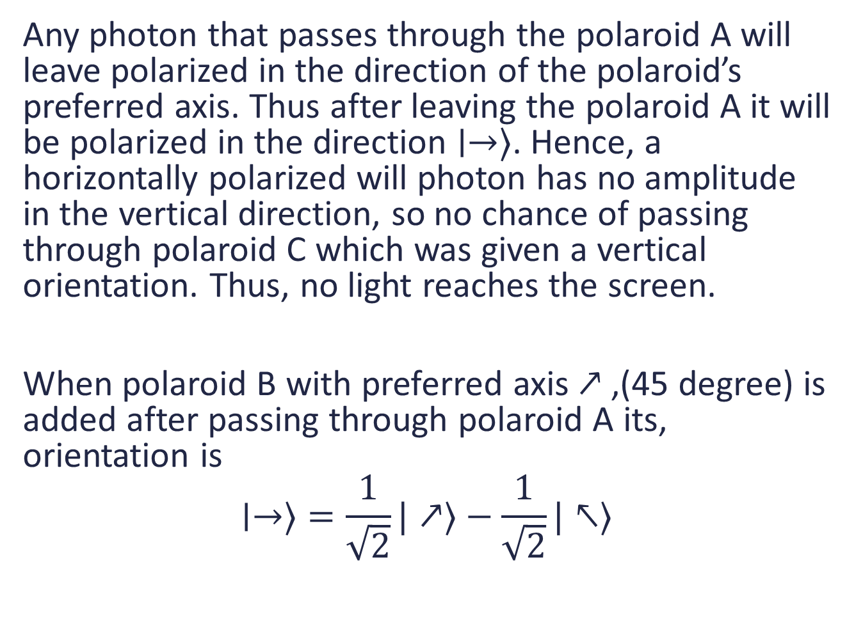
Any photon that passes through the polaroid A will leave polarized in the direction of the polaroid’s preferred axis. Thus after leaving the polaroid A it will be polarized in the direction $∣→⟩$. Hence, a horizontally polarized will photon has no amplitude in the vertical direction, so no chance of passing through polaroid C which was given a vertical orientation. Thus, no light reaches the screen.
When polaroid B with preferred axis $↗$,(45 degree) is added after passing through polaroid A its, orientation is
$$∣→⟩=\frac{1}{\sqrt{2}}|↗⟩−\frac{1}{\sqrt{2}}|↖⟩$$

Slide 12
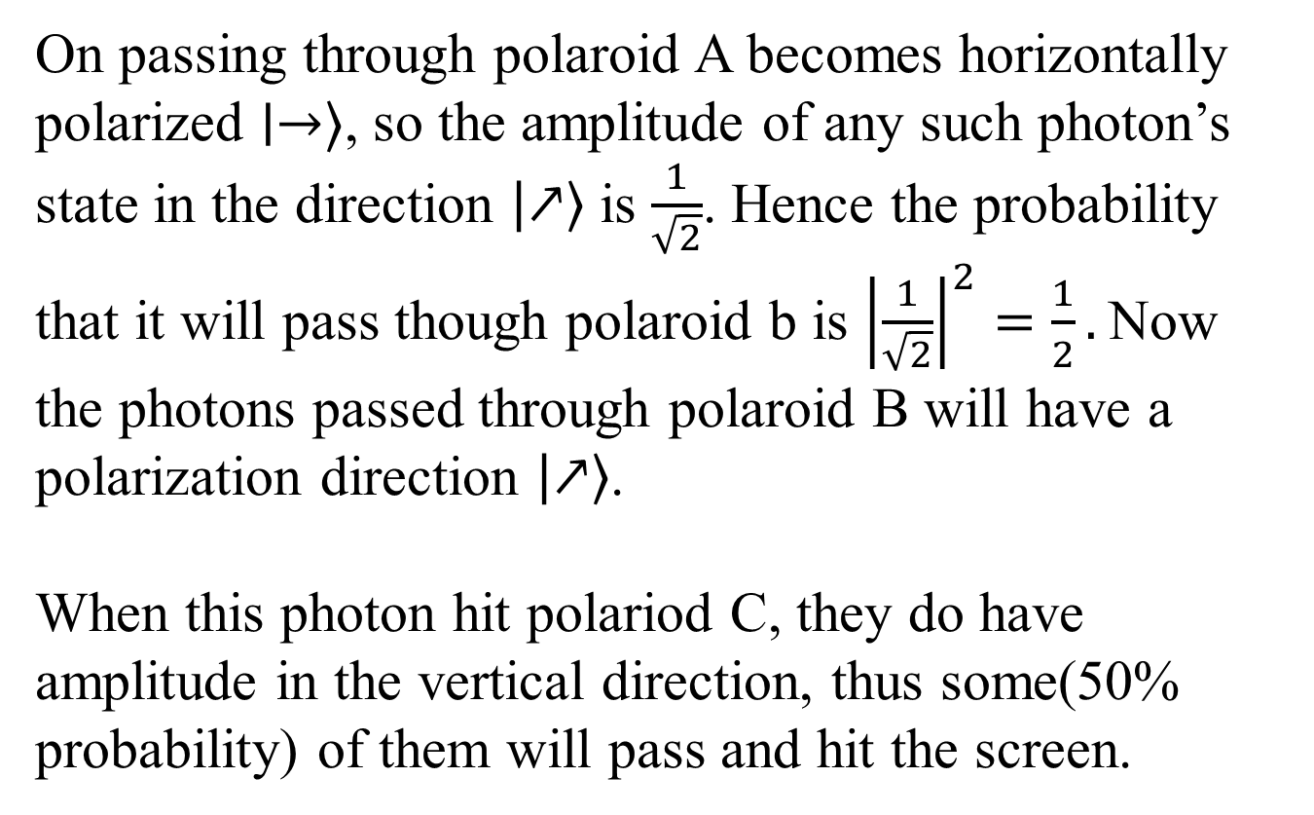
On passing through polaroid A becomes horizontally polarized $∣→⟩$, so the amplitude of any such photon’s state in the direction $\left|↗\right\rangle$ is $\frac{1}{\sqrt{2}}$. Hence the probability that it will pass though polaroid b is ${\left|\frac{1}{\sqrt{2}}\right|}^{2}=\frac{1}{2}.$Now the photons passed through polaroid B will have a polarization direction $\left|↗\right\rangle$.
When this photon hit polariod C, they do have amplitude in the vertical direction, thus some(50% probability) of them will pass and hit the screen.

Slide 13
Summary
The polarization state of a photon is modelled as a unit vector.
Its interaction with polaroid is probabilistic and depends on the amplitude of the photon’s polarization in the direction of the polaroid’s preferred axis. Either the photon will be absorbed, or the photon will leave the polaroid with its polarization aligned with the polaroid’s preferred axis.

Slide 14
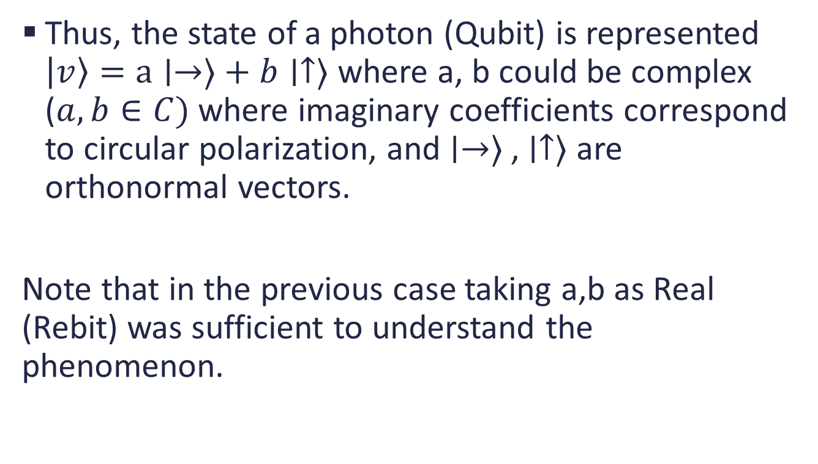
Thus, the state of a photon (Qubit) is represented $\left|v\right\rangle =a∣→⟩+b∣↑⟩$ where a, b could be complex ($a,b∈C)$ where imaginary coefficients correspond to circular polarization, and $∣→⟩$ , $∣↑⟩$ are orthonormal vectors.
Note that in the previous case taking a,b as Real (Rebit) was sufficient to understand the phenomenon.

Slide 15
Decoherence
You cannot observe i.e. measure a quantum state without changing it in some way. Hence, the phenomenon of decoherence refers to the fact that the qubits lose their state and properties as they interact with the environment in an uncontrollable way, thus the decoherence problem. We may not measure but the quantum system is continuously interacting with the quantum state.
To resist decoherence, we must prevent the environment from “learning” about the state of the quantum computer during the computation.
Hence information needs to be kept isolated from the environment. This is overcome by Quantum error Correction by using very non – local form, shared among many qubits. (Environment interacts locally).

Slide 16
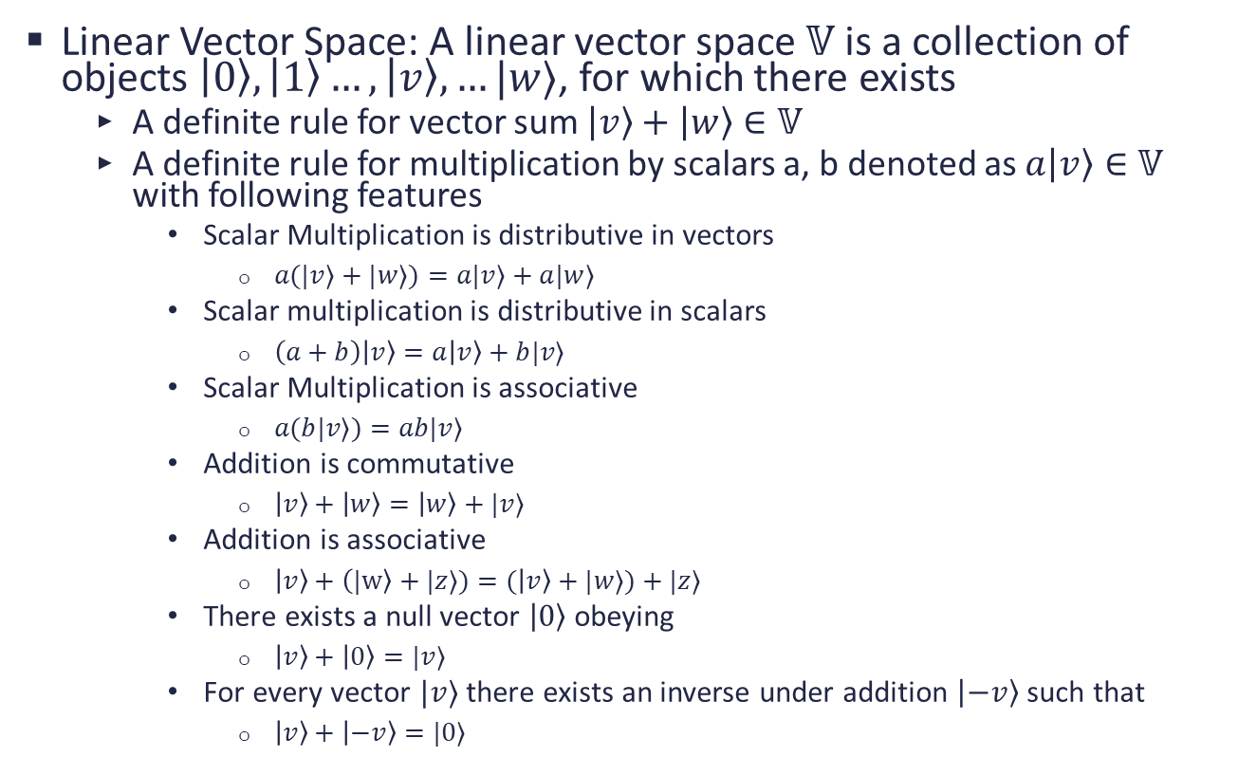
Mathematical Foundation
Linear Vector Space: A linear vector space $𝕍$ is a collection of objects $\left|0\right\rangle ,\left|1\right\rangle …,\left|v\right\rangle ,…|w⟩$, for which there exists
A definite rule for vector sum $\left|v\right\rangle +\left|w\right\rangle ∈𝕍$
A definite rule for multiplication by scalars a, b denoted as $a\left|v\right\rangle ∈𝕍$ with following features
Scalar Multiplication is distributive in vectors
$a(|v⟩+|w⟩)=a|v⟩+a|w⟩$
Scalar multiplication is distributive in scalars
$\left(a+b\right)\left|v\right\rangle =a\left|v\right\rangle +b|v⟩$
Scalar Multiplication is associative
$a(b|v⟩)=ab|v⟩$
Addition is commutative
$\left|v\right\rangle +\left|w\right\rangle =\left|w\right\rangle +|v⟩$
Addition is associative
$\left|v\right\rangle +\left(|w\right\rangle +|z⟩)=(\left|v\right\rangle +|w⟩)+|z⟩$
There exists a null vector $\left|0\right\rangle$obeying
$\left|v\right\rangle +\left|0\right\rangle =|v⟩$
For every vector $|v⟩$ there exists an inverse under addition $\left|−v\right\rangle$ such that
$\left|v\right\rangle +\left|−v\right\rangle =|0⟩$
The Laws hold irrespective of the basis chosen. Fixing the bases just fixes the component of the vector and expresses it in that bases. Changing the bases changes the component values of that vector in the new bases but the Laws still hold true.
Any object that satisfies these properties is a vector (not necessarily an arrow with a magnitude and a direction) and thus the definition of a vector space.

Slide 17
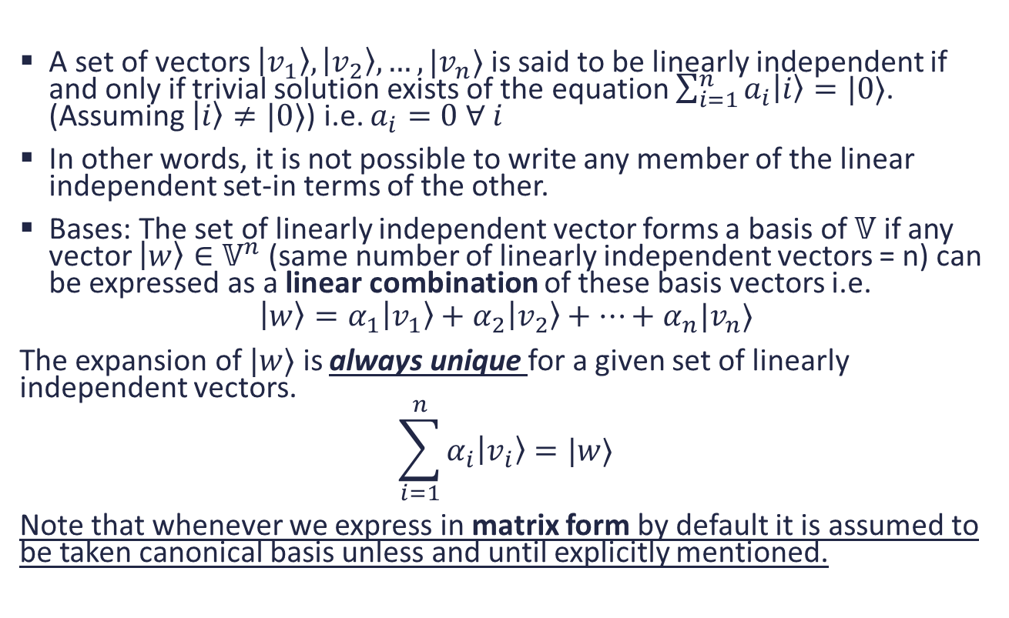
Linear Independence
A set of vectors $\left|v_{1}\right\rangle ,\left|v_{2}\right\rangle , …,|v_{n}⟩$ is said to be linearly independent if and only if trivial solution exists of the equation $\sum_{i=1}^{n}{a_{i}\left|i\right\rangle =|0⟩}$. (Assuming $\left|i\right\rangle ≠|0⟩$) i.e. $a_{i}=0 ∀ i$
In other words, it is not possible to write any member of the linear independent set-in terms of the other.
Bases: The set of linearly independent vector forms a basis of $𝕍$ if any vector $\left|w\right\rangle ∈𝕍^{n}$ (same number of linearly independent vectors = n) can be expressed as a linear combination of these basis vectors i.e.
$$\left|w\right\rangle =α_{1}\left|v_{1}\right\rangle +α_{2}\left|v_{2}\right\rangle +…+α_{n}|v_{n}⟩$$
The expansion of $|w⟩$ is always unique for a given set of linearly independent vectors.
$$\sum_{i=1}^{n}{α_{i}\left|v_{i}\right\rangle =|w⟩}$$
Note that whenever we express in matrix form by default it is assumed to be taken canonical basis unless and until explicitly mentioned.

Slide 18
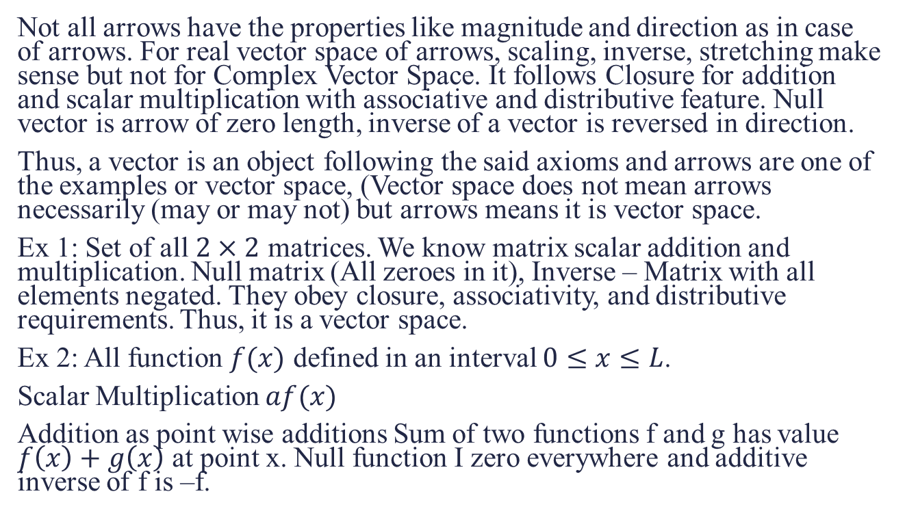
Examples of a Vector Space
Not all arrows have the properties like magnitude and direction as in case of arrows. For real vector space of arrows, scaling, inverse, stretching make sense but not for Complex Vector Space. It follows Closure for addition and scalar multiplication with associative and distributive feature. Null vector is arrow of zero length, inverse of a vector is reversed in direction.
Thus, a vector is an object following the said axioms and arrows are one of the examples or vector space, (Vector space does not mean arrows necessarily (may or may not) but arrows means it is vector space.
Ex 1: Set of all $2×2$ matrices. We know matrix scalar addition and multiplication. Null matrix (All zeroes in it), Inverse – Matrix with all elements negated. They obey closure, associativity, and distributive requirements. Thus, it is a vector space.
Ex 2: All function $f(x)$ defined in an interval $0≤x≤L$.
Scalar Multiplication $af(x)$
Addition as point wise additions Sum of two functions f and g has value $f\left(x\right)+g\left(x\right)$ at point x. Null function I zero everywhere and additive inverse of f is –f.

Slide 19
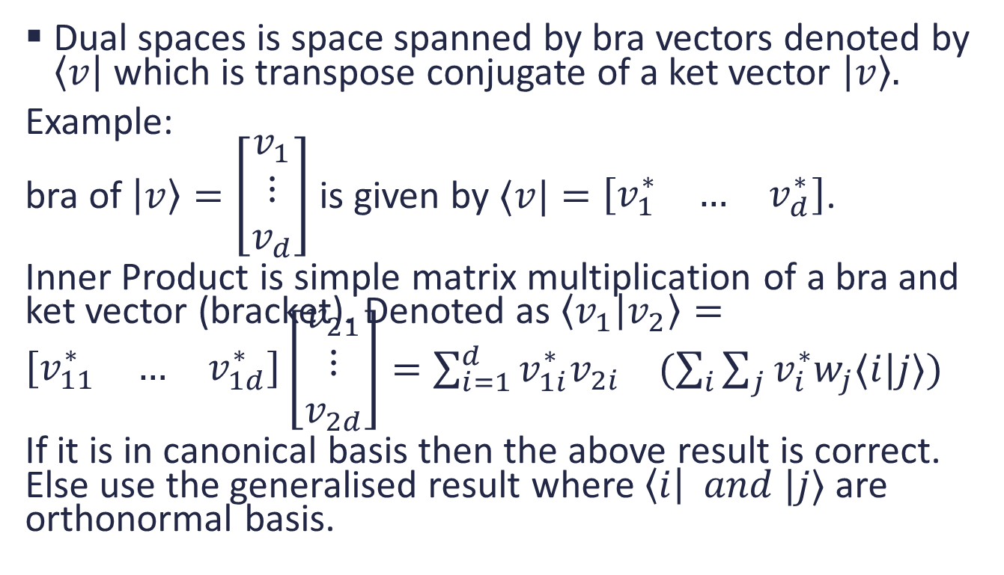
Dual Spaces and Inner Product
Dual spaces is space spanned by bra vectors denoted by $\left\langle v\right|$ which is transpose conjugate of a ket vector $\left|v\right\rangle .$
Example:
bra of $\left|v\right\rangle =\left[\begin{matrix}v_{1} \\ ⋮ \\ v_{d}\end{matrix}\right]$ is given by $⟨v|=\left[\begin{matrix}v_{1}^{∗} & … & v_{d}^{∗}\end{matrix}\right]$.
Inner Product is simple matrix multiplication of a bra and ket vector (bracket). Denoted as $\left\langle v_{1} | v_{2}\right\rangle =\left[\begin{matrix}v_{11}^{∗} & … & v_{1d}^{∗}\end{matrix}\right]\left[\begin{matrix}v_{21} \\ ⋮ \\ v_{2d}\end{matrix}\right]=\sum_{i=1}^{d}{v_{1i}^{∗}v_{2i}}$ $(\sum_{i}{\sum_{j}{v_{i}^{∗}w_{j}⟨i|j⟩)}}$
If it is in canonical basis then the above result is correct. Else use the generalised result where $\left\langle i\right| and |j⟩$ are orthonormal basis.

Slide 20
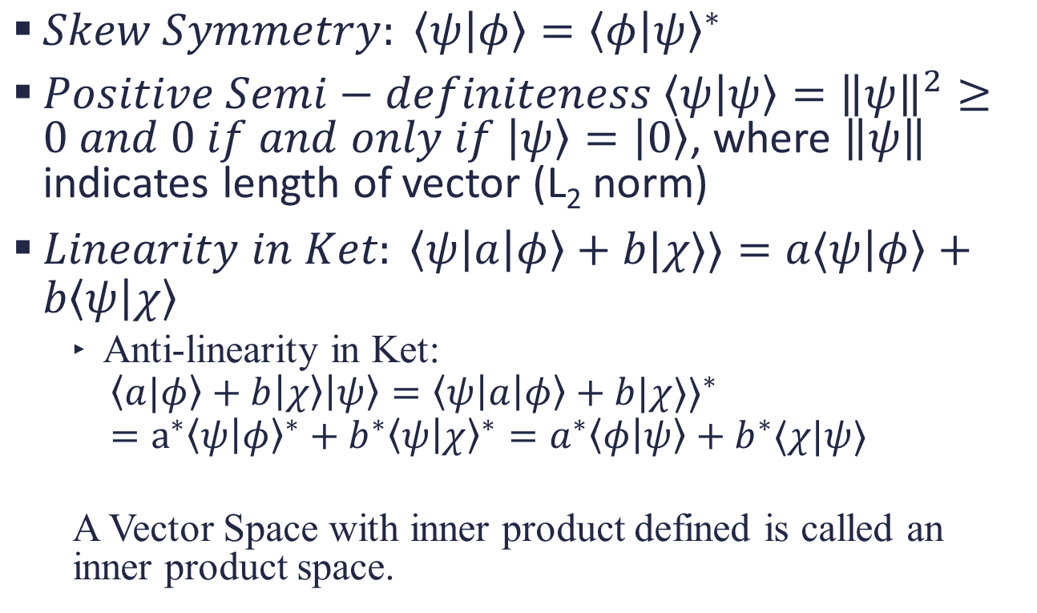
Properties of Inner Product
$Skew Symmetry: \left\langle ψ | φ\right\rangle ={\left\langle φ | ψ\right\rangle }^{∗}$
$Positive Semi−definiteness \left\langle ψ | ψ\right\rangle ={\left\|ψ\right\|}^{2}≥0 and 0 if and only if \left|ψ\right\rangle =\left|0\right\rangle$, where $\left\|ψ\right\|$ indicates length of vector (L₂ norm)
$Linearity in Ket: \left\langle ψ\left|a\right|φ\right\rangle +b|χ⟩⟩=a⟨ψ\left|φ\right\rangle +b\left\langle ψ | χ\right\rangle$
Anti-linearity in Ket:
$$\left\langle a|φ\right\rangle +b\left|χ\right\rangle \left|ψ\right\rangle ={\left\langle ψ\left|a\right|φ\right\rangle +b|χ⟩⟩}^{∗}=a^{∗}{\left\langle ψ | φ\right\rangle }^{∗}+b^{∗}{\left\langle ψ | χ\right\rangle }^{∗}=a^{∗}\left\langle φ | ψ\right\rangle +b^{∗}⟨χ|ψ⟩$$
A Vector Space with inner product defined is called an inner product space.

Slide 21
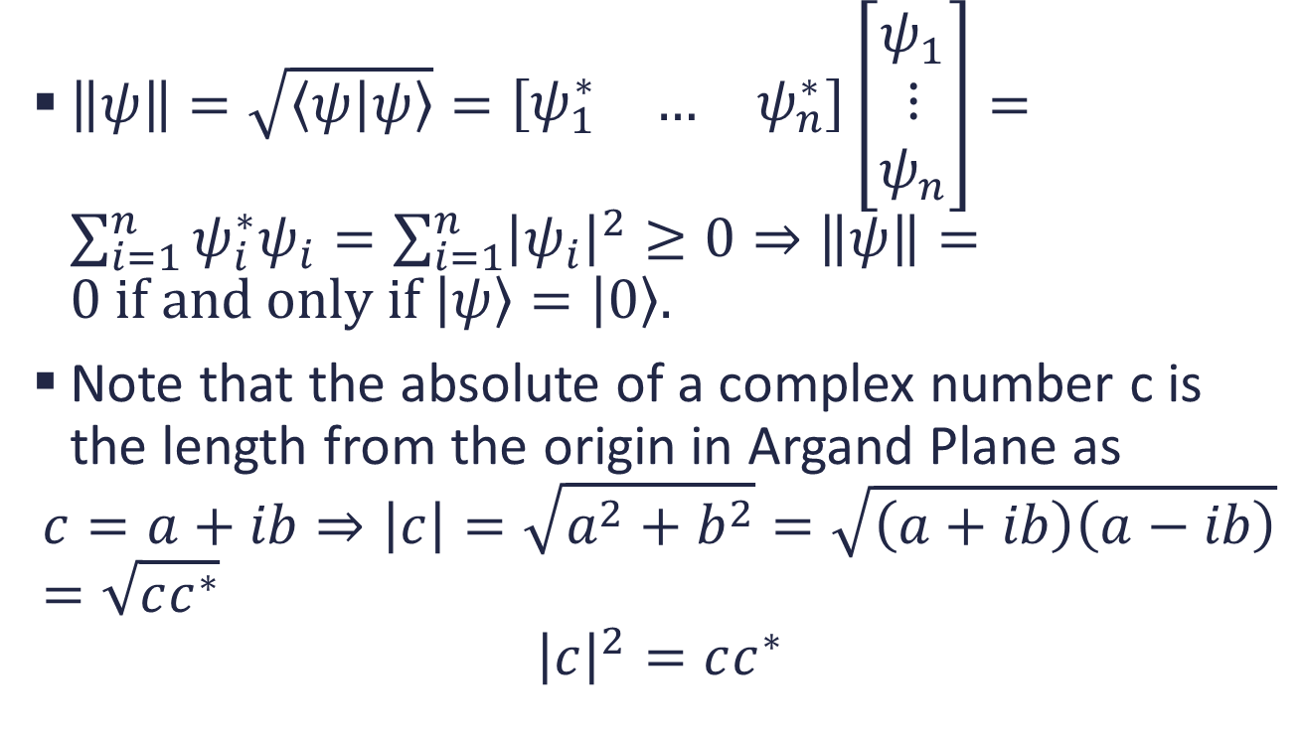
Euclidian Norm of Vector
$\left\|ψ\right\|=\sqrt{\left\langle ψ | ψ\right\rangle }=\left[\begin{matrix}ψ_{1}^{∗} & … & ψ_{n}^{∗}\end{matrix}\right]\left[\begin{matrix}ψ_{1} \\ ⋮ \\ ψ_{n}\end{matrix}\right]=\sum_{i=1}^{n}{ψ_{i}^{∗}ψ_{i}}=\sum_{i=1}^{n}{{\left|ψ_{i}\right|}^{2}}≥0⇒\left\|ψ\right\|=0 if and only if \left|ψ\right\rangle =\left|0\right\rangle .$
Note that the absolute of a complex number c is the length from the origin in Argand Plane as
$$c=a+ib⇒\left|c\right|=\sqrt{a^{2}+b^{2}}=\sqrt{\left(a+ib\right)\left(a−ib\right)}=\sqrt{cc^{∗}}$$
$${\left|c\right|}^{2}=cc^{∗}$$

Slide 22
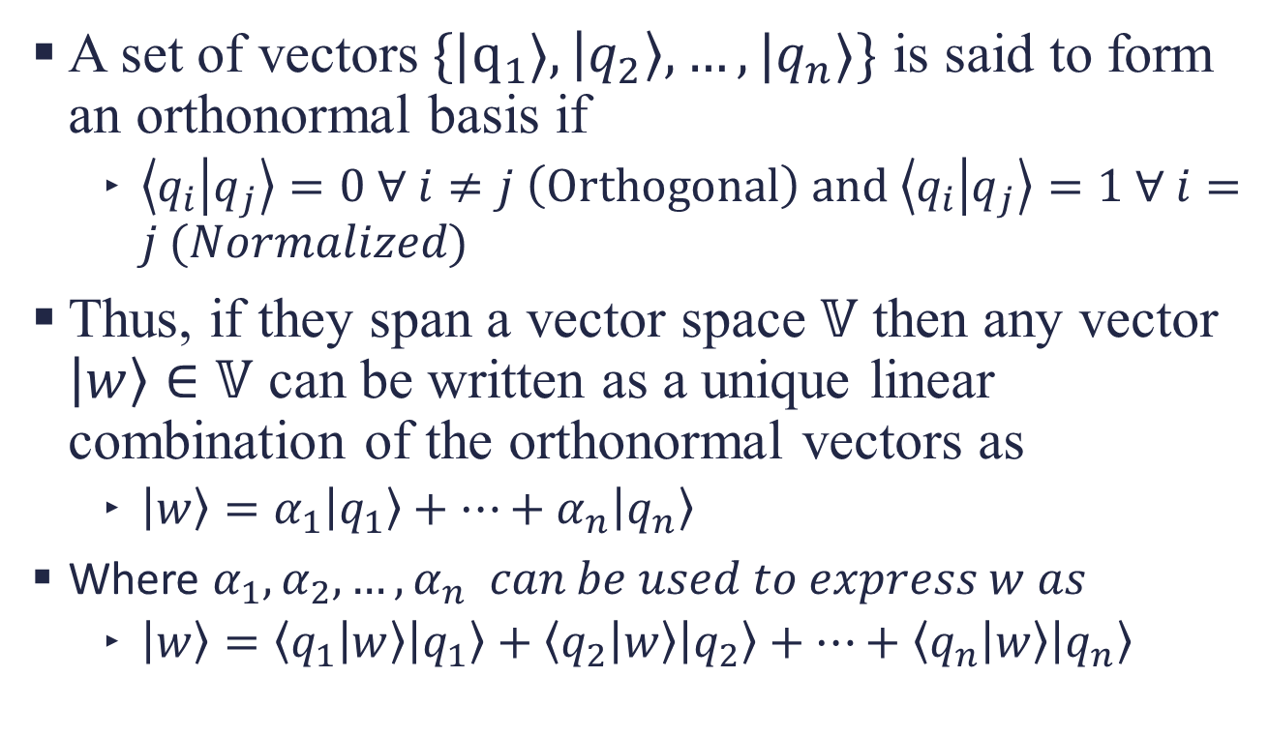
Orthonormal Basis
A set of vectors$\{|q_{1}⟩,\left|q_{2}\right\rangle ,…,|q_{n}⟩\}$ is said to form an orthonormal basis if
$\left\langle q_{i} | q_{j}\right\rangle =0 ∀ i≠j \left(Orthogonal\right) and \left\langle q_{i} | q_{j}\right\rangle =1 ∀ i=j (Normalized)$
Thus, if they span a vector space $𝕍$ then any vector $\left|w\right\rangle ∈𝕍$ can be written as a unique linear combination of the orthonormal vectors as
$\left|w\right\rangle =α_{1}\left|q_{1}\right\rangle +…+α_{n}\left|q_{n}\right\rangle$
Where $α_{1},α_{2},…,α_{n} can be used to express w as$
$\left|w\right\rangle =\left\langle q_{1} | w\right\rangle \left|q_{1}\right\rangle +\left\langle q_{2} | w\right\rangle \left|q_{2}\right\rangle +…+\left\langle q_{n} | w\right\rangle \left|q_{n}\right\rangle$

Slide 23
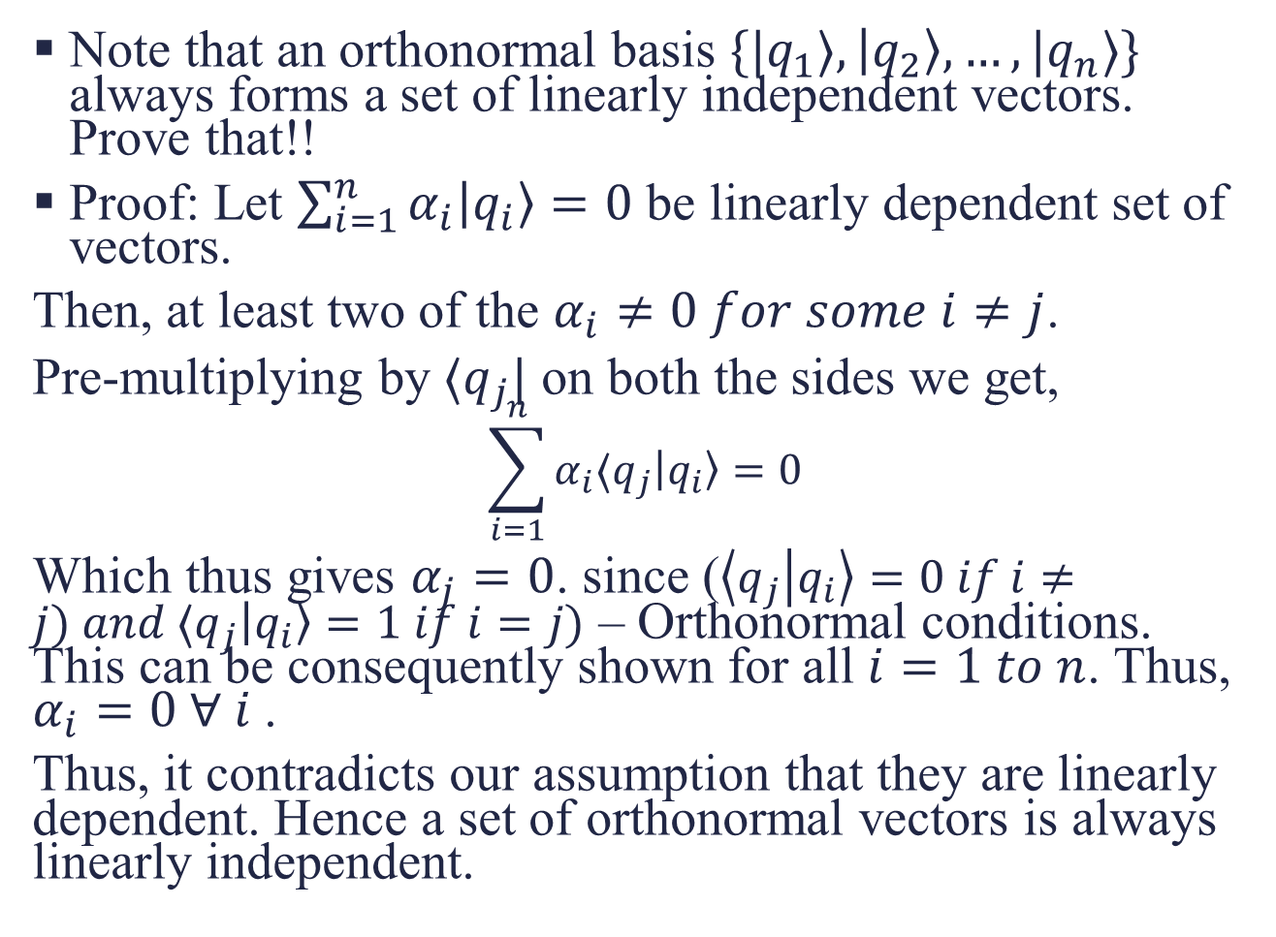
Note that an orthonormal basis $\{|q_{1}⟩,\left|q_{2}\right\rangle ,…,|q_{n}⟩\}$ always forms a set of linearly independent vectors. Prove that!!
Proof: Let $\sum_{i=1}^{n}{α_{i}\left|q_{i}\right\rangle =0}$ be linearly dependent set of vectors.
Then, at least two of the $α_{i}≠0 for some i≠j$.
Pre-multiplying by $⟨q_{j}|$ on both the sides we get,
$$\sum_{i=1}^{n}{α_{i}⟨q_{j}\left|q_{i}\right\rangle =0}$$
Which thus gives $α_{j}=0$. since ($\left\langle q_{j} | q_{i}\right\rangle =0 if i≠j) and ⟨q_{j}\left|q_{i}\right\rangle =1 if i=j)$ – Orthonormal conditions. This can be consequently shown for all $i=1 to n$. Thus, $α_{i}=0 ∀ i$.
Thus, it contradicts our assumption that they are linearly dependent. Hence a set of orthonormal vectors is always linearly independent.

Slide 24
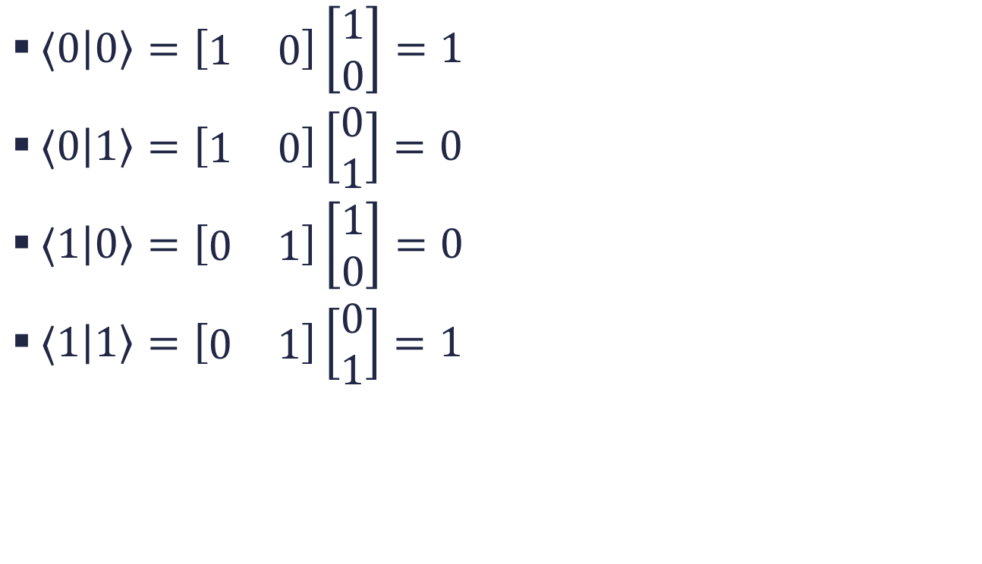
Examples
$⟨0\left|0\right\rangle =\left[\begin{matrix}1 & 0\end{matrix}\right]\left[\begin{matrix}1 \\ 0\end{matrix}\right]=1$
$⟨0\left|1\right\rangle =\left[\begin{matrix}1 & 0\end{matrix}\right]\left[\begin{matrix}0 \\ 1\end{matrix}\right]=0$
$⟨1\left|0\right\rangle =\left[\begin{matrix}0 & 1\end{matrix}\right]\left[\begin{matrix}1 \\ 0\end{matrix}\right]=0$
$⟨1\left|1\right\rangle =\left[\begin{matrix}0 & 1\end{matrix}\right]\left[\begin{matrix}0 \\ 1\end{matrix}\right]=1$

Slide 25
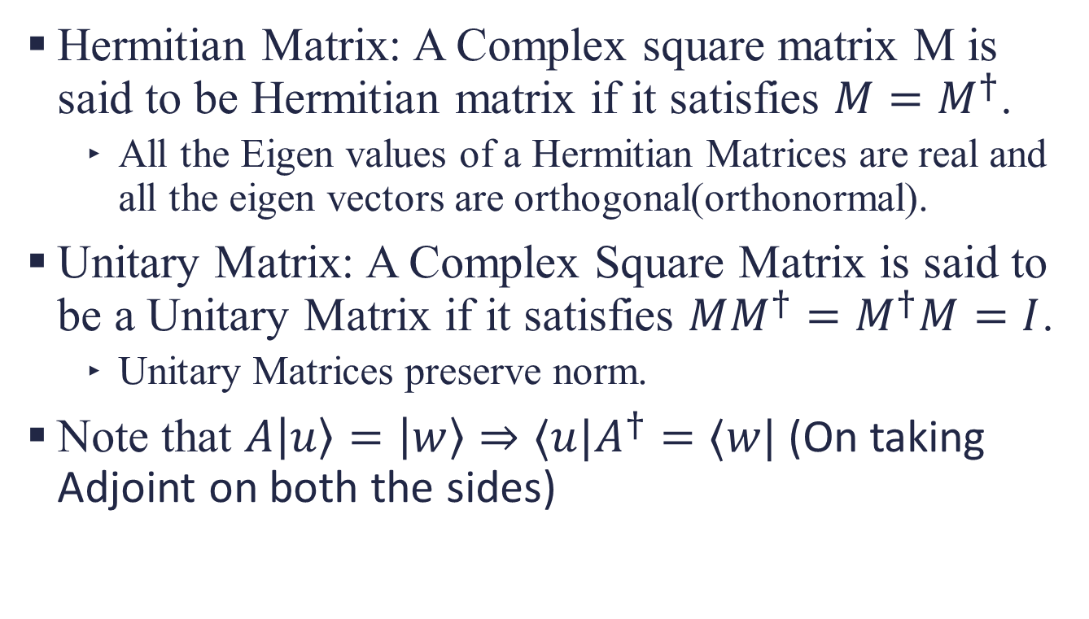
Hermitian Matrix and Unitary Matrix
Hermitian Matrix: A Complex square matrix M is said to be Hermitian matrix if it satisfies $M=M^{†}$.
All the Eigen values of a Hermitian Matrices are real and all the eigen vectors are orthogonal(orthonormal).
Unitary Matrix: A Complex Square Matrix is said to be a Unitary Matrix if it satisfies $MM^{†}=M^{†}M=I$.
Unitary Matrices preserve norm.
Note that $A\left|u\right\rangle =\left|w\right\rangle ⇒⟨u|A^{†}=⟨w|$ (On taking Adjoint on both the sides)

Slide 26
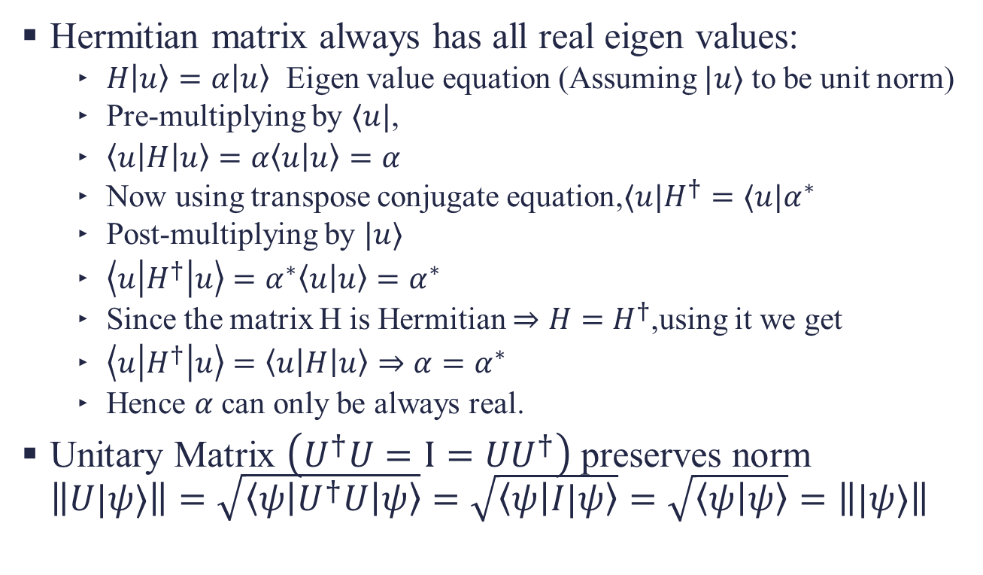
Proofs
Hermitian matrix always has all real eigen values:
$H\left|u\right\rangle =α\left|u\right\rangle$ Eigen value equation (Assuming $|u⟩$ to be unit norm)
Pre-multiplying by $⟨u|$,
$\left\langle u\left|H\right|u\right\rangle =α\left\langle u | u\right\rangle =α$
Now using transpose conjugate equation,$⟨u|H^{†}=⟨u|α^{∗}$
Post-multiplying by $|u⟩$
$\left\langle u\left|H^{†}\right|u\right\rangle =α^{∗}\left\langle u | u\right\rangle =α^{∗}$
Since the matrix H is Hermitian $⇒H=H^{†}$,using it we get
$\left\langle u\left|H^{†}\right|u\right\rangle =\left\langle u\left|H\right|u\right\rangle ⇒α=α^{∗}$
Hence $α$ can only be always real.
Unitary Matrix $\left(U^{†}U=I={UU}^{†}\right)$ preserves norm $\left\|U|ψ⟩\right\|=\sqrt{\left\langle ψ\left|U^{†}U\right|ψ\right\rangle }=\sqrt{\left\langle ψ | I|ψ\right\rangle }=\sqrt{\left\langle ψ | ψ\right\rangle }=\left\||ψ⟩\right\|$

Slide 27
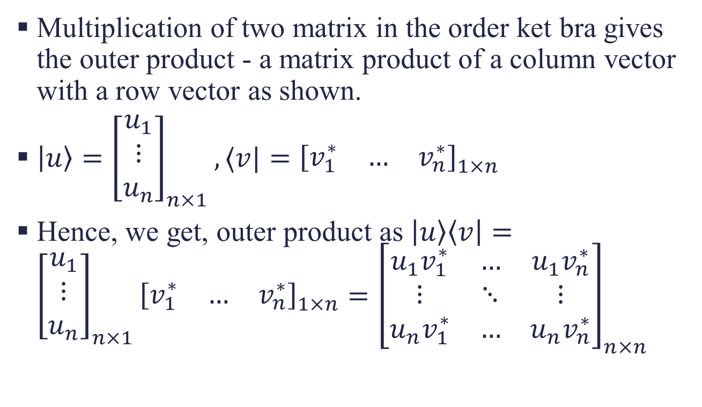
Outer Product - ketbra
Multiplication of two matrix in the order ket bra gives the outer product - a matrix product of a column vector with a row vector as shown.
$\left|u\right\rangle ={\left[\begin{matrix}u_{1} \\ ⋮ \\ u_{n}\end{matrix}\right]}_{n×1}, ⟨v|={\left[\begin{matrix}v_{1}^{∗} & … & v_{n}^{∗}\end{matrix}\right]}_{1×n}$
Hence, we get, outer product as $\left|u\right\rangle \left\langle v\right|={\left[\begin{matrix}u_{1} \\ ⋮ \\ u_{n}\end{matrix}\right]}_{n×1}{\left[\begin{matrix}v_{1}^{∗} & … & v_{n}^{∗}\end{matrix}\right]}_{1×n}={\left[\begin{matrix}u_{1}v_{1}^{∗} & … & u_{1}v_{n}^{∗} \\ ⋮ & ⋱ & ⋮ \\ u_{n}v_{1}^{∗} & … & u_{n}v_{n}^{∗}\end{matrix}\right]}_{n×n}$

Slide 28
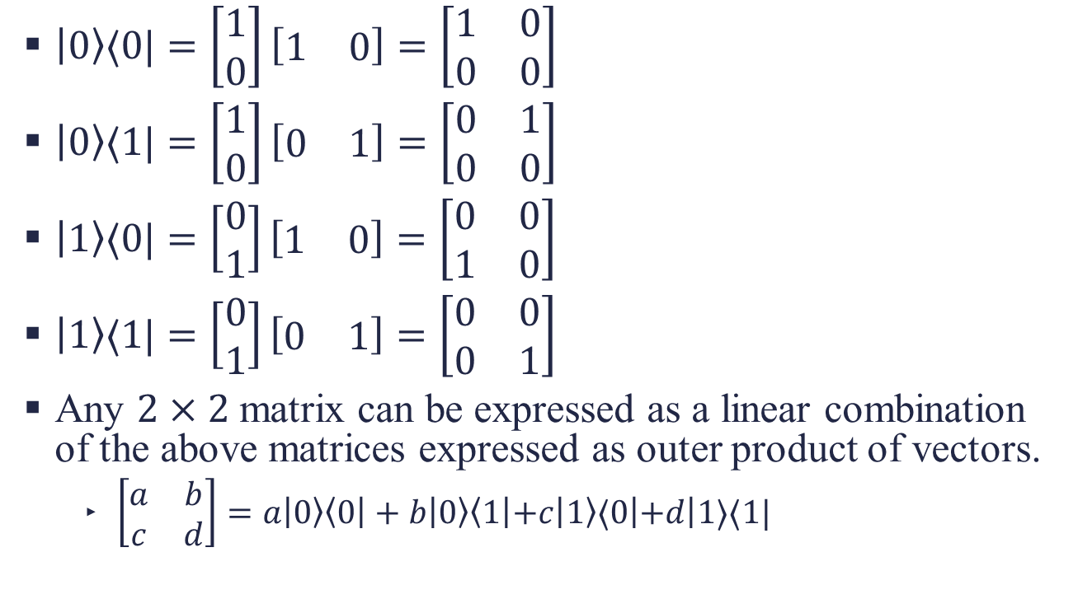
Examples
$\left|0\right\rangle ⟨0|=\left[\begin{matrix}1 \\ 0\end{matrix}\right]\left[\begin{matrix}1 & 0\end{matrix}\right]=\left[\begin{matrix}1 & 0 \\ 0 & 0\end{matrix}\right]$
$\left|0\right\rangle ⟨1|=\left[\begin{matrix}1 \\ 0\end{matrix}\right]\left[\begin{matrix}0 & 1\end{matrix}\right]=\left[\begin{matrix}0 & 1 \\ 0 & 0\end{matrix}\right]$
$\left|1\right\rangle ⟨0|=\left[\begin{matrix}0 \\ 1\end{matrix}\right]\left[\begin{matrix}1 & 0\end{matrix}\right]=\left[\begin{matrix}0 & 0 \\ 1 & 0\end{matrix}\right]$
$\left|1\right\rangle ⟨1|=\left[\begin{matrix}0 \\ 1\end{matrix}\right]\left[\begin{matrix}0 & 1\end{matrix}\right]=\left[\begin{matrix}0 & 0 \\ 0 & 1\end{matrix}\right]$
Any $2×2$ matrix can be expressed as a linear combination of the above matrices expressed as outer product of vectors.
$\left[\begin{matrix}a & b \\ c & d\end{matrix}\right]=a\left|0\right\rangle \left\langle 0\right|+b\left|0\right\rangle \left\langle 1\left|+c\right|1\right\rangle ⟨0\left|+d\right|1⟩⟨1|$

Slide 29
Literature Review
Let’s see what’s out there

Slide 30
Solution of time-independent Schrodinger Equation by ITP
Numerical Solution of Eigen values and Eigenvectors of large matrices – originating from discretization of linear and non-linear Schrodinger Equations. – solved by ITP method
Convergence properties of 2nd and 4th order operator-splitting methods by ITP with examples.
Natural convergence of method is further accelerated with dynamic time step adjustment method.
Results: Better scaling with respect to matrix size compared to implicitly restarted Lanczos method. (Efficient parallel implementation of ITP method for shared memory computer demonstrated).
[1] LEHTOVAARA2007148

Slide 31
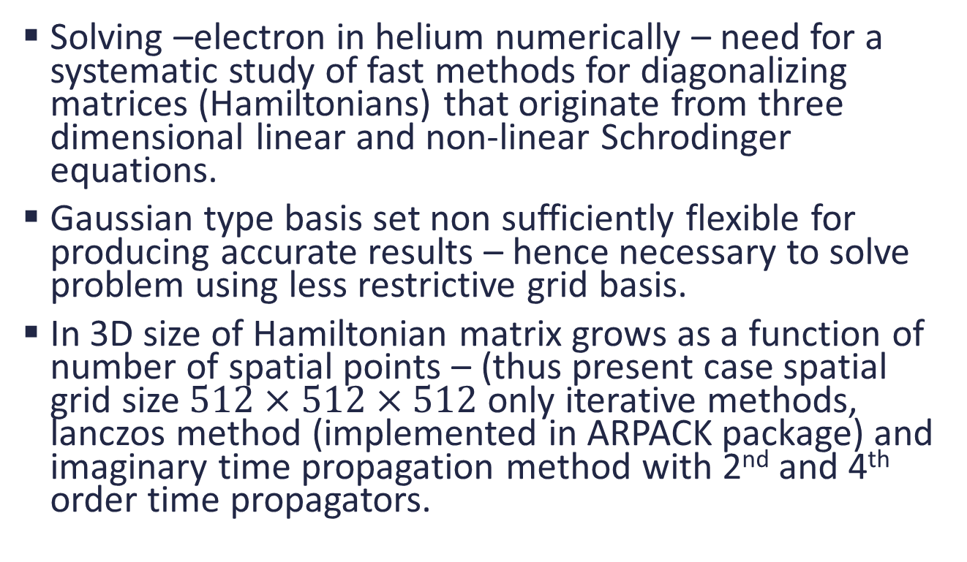
Introduction
Solving –electron in helium numerically – need for a systematic study of fast methods for diagonalizing matrices (Hamiltonians) that originate from three dimensional linear and non-linear Schrodinger equations.
Gaussian type basis set non sufficiently flexible for producing accurate results – hence necessary to solve problem using less restrictive grid basis.
In 3D size of Hamiltonian matrix grows as a function of number of spatial points – (thus present case spatial grid size $512×512×512$ only iterative methods, lanczos method (implemented in ARPACK package) and imaginary time propagation method with 2nd and 4th order time propagators.

Slide 32
Lanczos method used as a reference.
ITP – a key element in Monte-Carlo based approaches.
ITP – implemented in 3D using operator splitting technique – Splitting of Kinetic and potential parts in Schordinger Equation involves an error that is proportional to the power of the time step and depends on the accuracy of splitting scheme.
With a given splitting scheme , the exponential operators must be propagated over shorter time steps. This can be carried out convinently

Slide 33
Postulates of Quantum Mechanics
Quantum Computation and Information
Assuming that the reader has knowledge of vectors, linear vector space, bases, dimension, linear independence and orthonormal vectors, Hermitian matrix, Unitary matrix, Complex Numbers.

Slide 34
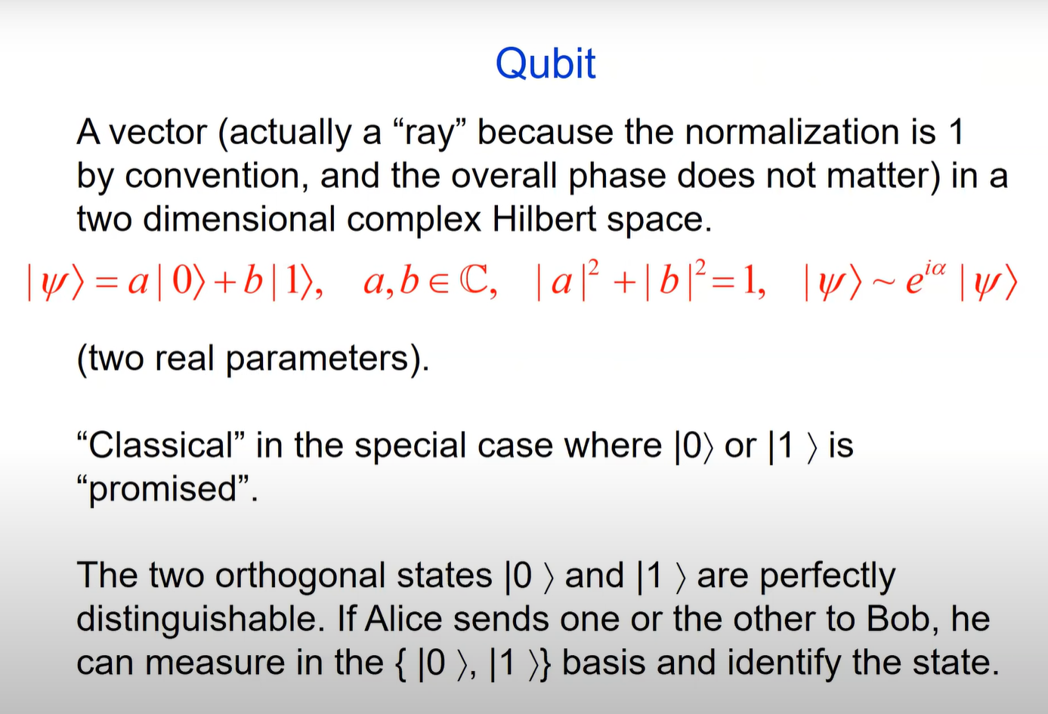

Slide 35
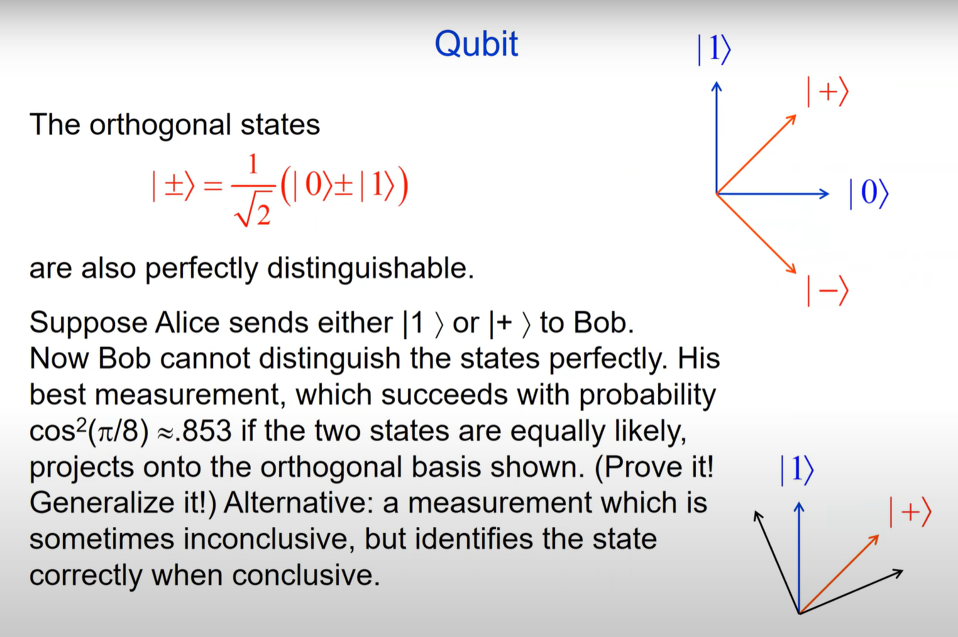
Non – orthogonal states cannot be perfectly distinguishable in Quantum Mechanics.

Slide 36
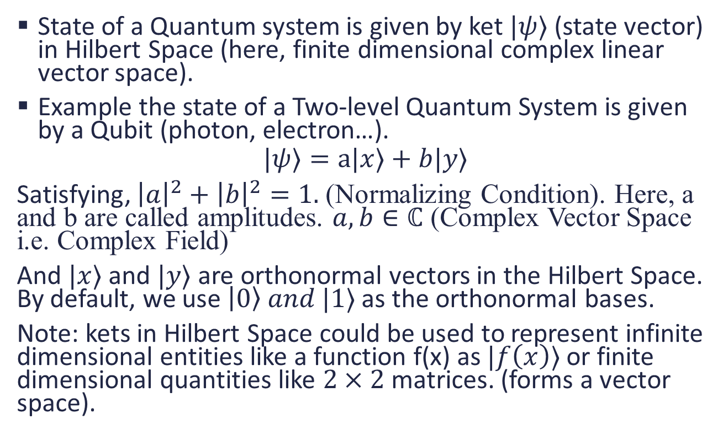
Postulate 1: State Vector
State of a Quantum system is given by ket $|ψ⟩$ (state vector) in Hilbert Space (here, finite dimensional complex linear vector space).
Example the state of a Two-level Quantum System is given by a Qubit (photon, electron…).
$$|ψ⟩=a|x⟩+b|y⟩$$
Satisfying, ${\left|a\right|}^{2}+{\left|b\right|}^{2}=1.$ (Normalizing Condition). Here, a and b are called amplitudes. $a,b∈ℂ$ (Complex Vector Space i.e. Complex Field)
And $|x⟩$ and $|y⟩$ are orthonormal vectors in the Hilbert Space. By default, we use $\left|0\right\rangle and |1⟩$ as the orthonormal bases.
Note: kets in Hilbert Space could be used to represent infinite dimensional entities like a function f(x) as $|f\left(x\right)⟩$ or finite dimensional quantities like $2×2$ matrices. (forms a vector space).

Slide 37
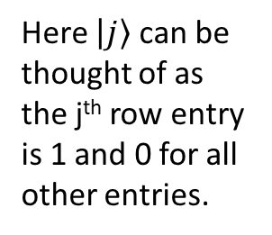
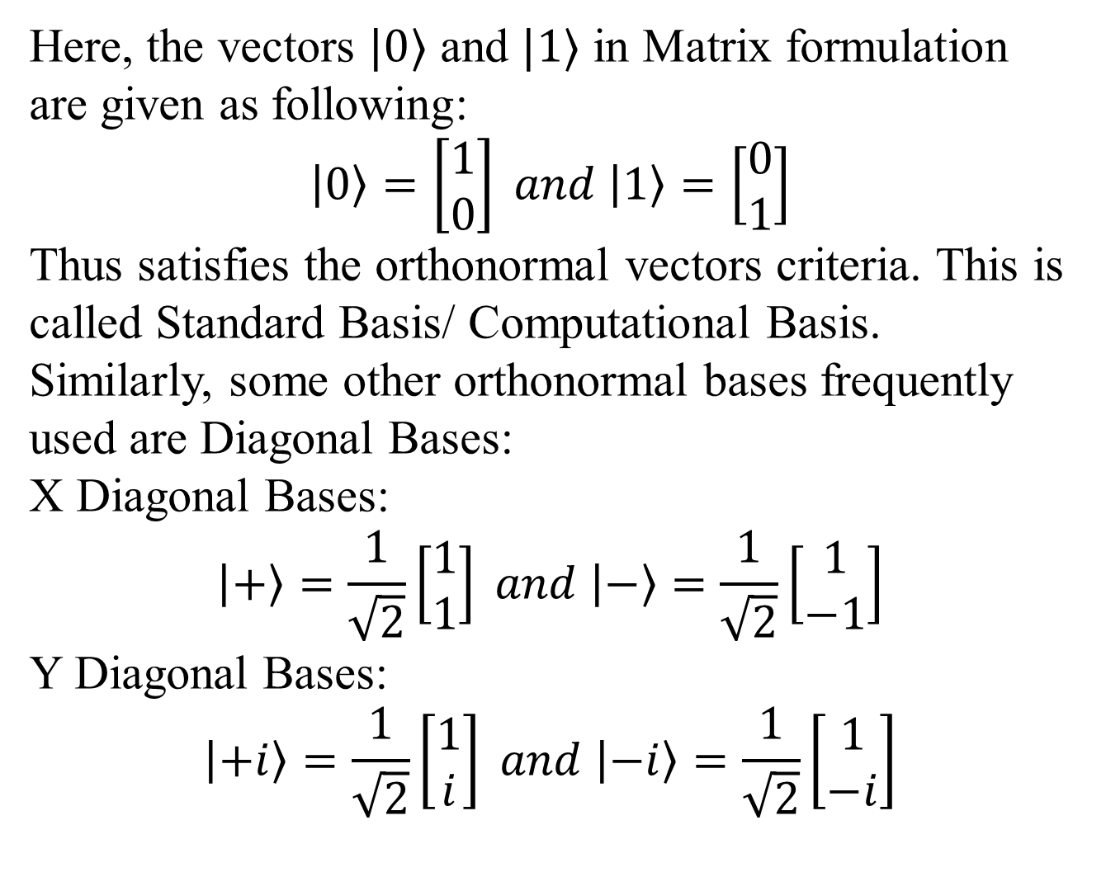
Here, the vectors $|0⟩$ and $|1⟩$ in Matrix formulation are given as following:
$$\left|0\right\rangle =\left[\begin{matrix}1 \\ 0\end{matrix}\right] and \left|1\right\rangle =\left[\begin{matrix}0 \\ 1\end{matrix}\right]$$
Thus satisfies the orthonormal vectors criteria. This is called Standard Basis/ Computational Basis.
Similarly, some other orthonormal bases frequently used are Diagonal Bases:
X Diagonal Bases:
$$\left|+\right\rangle =\frac{1}{\sqrt{2}}\left[\begin{matrix}1 \\ 1\end{matrix}\right] and \left|−\right\rangle =\frac{1}{\sqrt{2}}\left[\begin{matrix}1 \\ −1\end{matrix}\right]$$
Y Diagonal Bases:
$$\left|+i\right\rangle =\frac{1}{\sqrt{2}}\left[\begin{matrix}1 \\ i\end{matrix}\right] and \left|−i\right\rangle =\frac{1}{\sqrt{2}}\left[\begin{matrix}1 \\ −i\end{matrix}\right]$$
Here $\left|j\right\rangle$ can be thought of as the j^{th} row entry is 1 and 0 for all other entries.

Slide 38
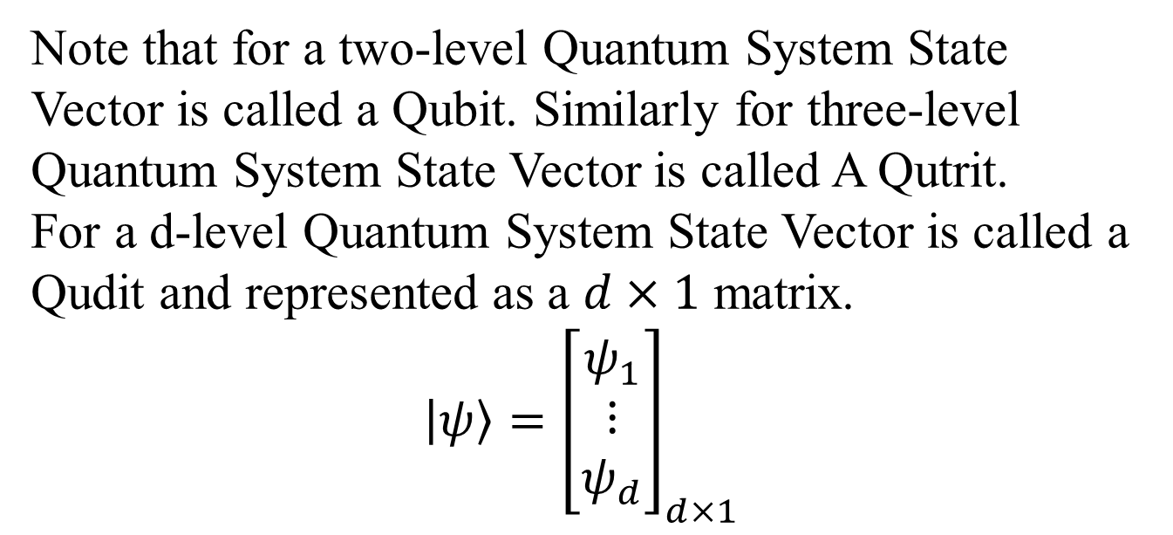
Note that for a two-level Quantum System State Vector is called a Qubit. Similarly for three-level Quantum System State Vector is called A Qutrit.
For a d-level Quantum System State Vector is called a Qudit and represented as a $d×1$ matrix.
$$\left|ψ\right\rangle ={\left[\begin{matrix}ψ_{1} \\ ⋮ \\ ψ_{d}\end{matrix}\right]}_{d×1}$$

Slide 39
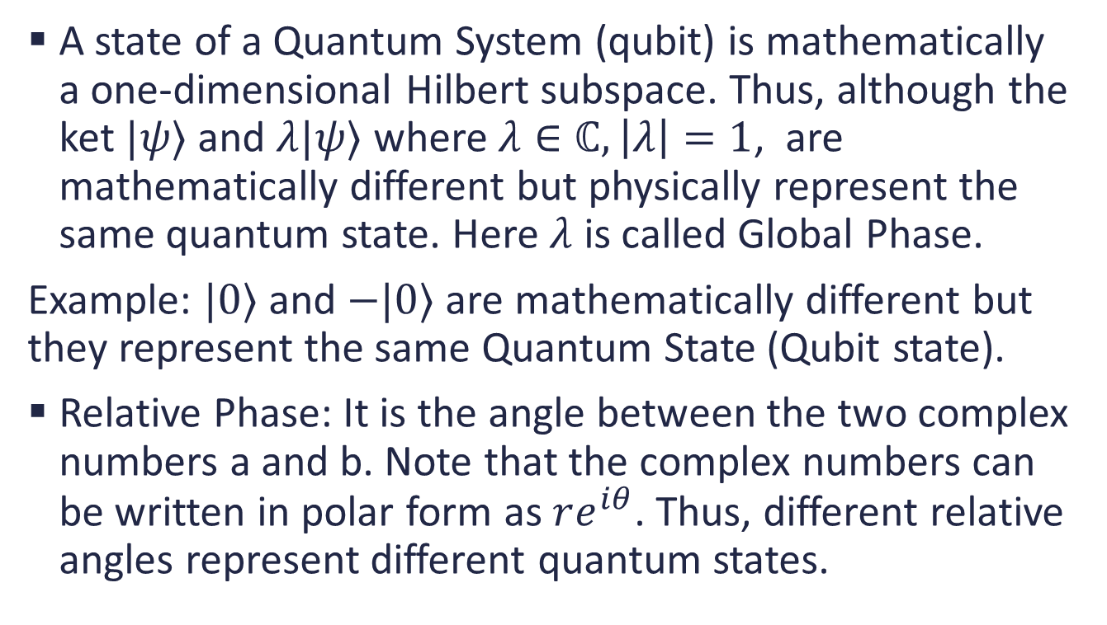
Conclusions from Postulate 1
A state of a Quantum System (qubit) is mathematically a one-dimensional Hilbert subspace. Thus, although the ket $|ψ⟩$ and $λ|ψ⟩$ where $λ∈ℂ,\left|λ\right|=1$, are mathematically different but physically represent the same quantum state. Here $λ$ is called Global Phase.
Example: $|0⟩$ and $−|0⟩$ are mathematically different but they represent the same Quantum State (Qubit state).
Relative Phase: It is the angle between the two complex numbers a and b. Note that the complex numbers can be written in polar form as $re^{iθ}$. Thus, different relative angles represent different quantum states.

Slide 40
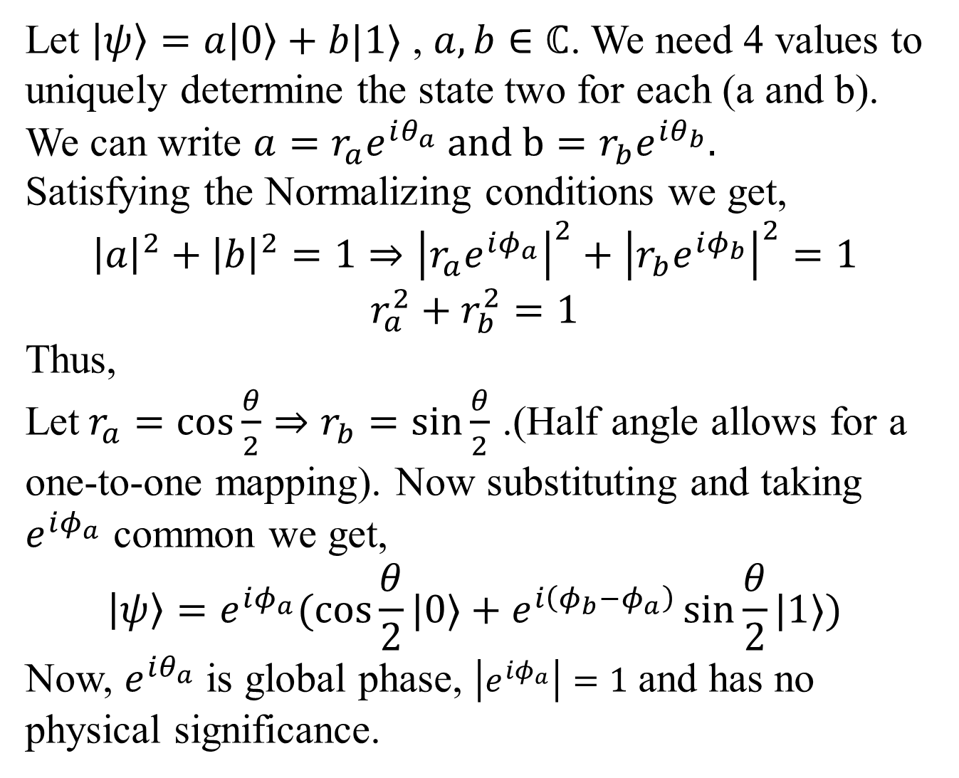
Let $\left|ψ\right\rangle =a\left|0\right\rangle +b|1⟩$ , $a,b∈ℂ$. We need 4 values to uniquely determine the state two for each (a and b).
We can write $a=r_{a}e^{iθ_{a}} and b=r_{b}e^{iθ_{b}}.$
Satisfying the Normalizing conditions we get,
$${\left|a\right|}^{2}+{\left|b\right|}^{2}=1⇒{\left|r_{a}e^{iφ_{a}}\right|}^{2}+{\left|r_{b}e^{iφ_{b}}\right|}^{2}=1$$
$$r_{a}^{2}+r_{b}^{2}=1$$
Thus,
Let$r_{a}=\cos{\frac{θ}{2}}⇒r_{b}=\sin{\frac{θ}{2}}$ .(Half angle allows for a one-to-one mapping). Now substituting and taking $e^{iφ_{a}}$ common we get,
$$\left|ψ\right\rangle =e^{iφ_{a}}(\cos{\frac{θ}{2}}|0⟩+e^{i\left(φ_{b}−φ_{a}\right)}\sin{\frac{θ}{2}}|1⟩)$$
Now, $e^{iθ_{a}}$ is global phase, $\left|e^{iφ_{a}}\right|=1$ and has no physical significance.

Slide 41
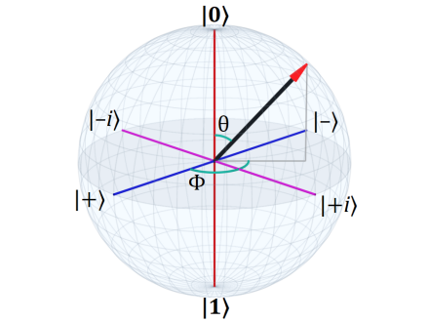
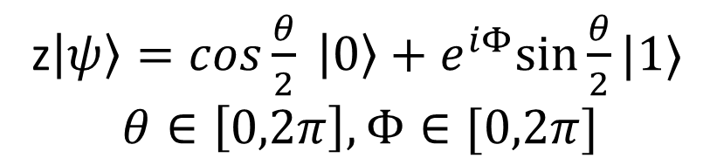
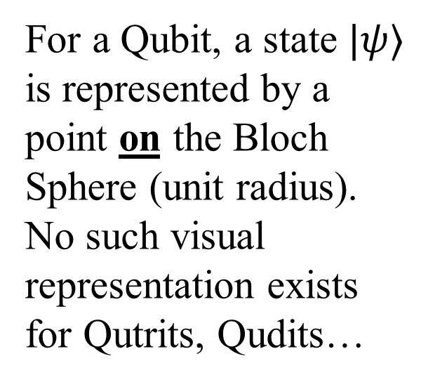
Bloch-Poincare Sphere
z$\left|ψ\right\rangle =cos\frac{θ}{2} \left|0\right\rangle +e^{iΦ}sin⁡\frac{θ}{2}|1⟩$
$$θ∈\left[0,2π\right],Φ∈[0,2π]$$
For a Qubit, a state $|ψ⟩$ is represented by a point on the Bloch Sphere (unit radius). No such visual representation exists for Qutrits, Qudits…

Slide 42
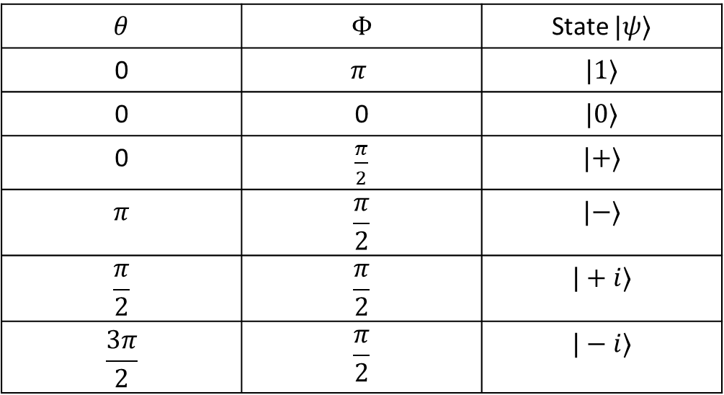
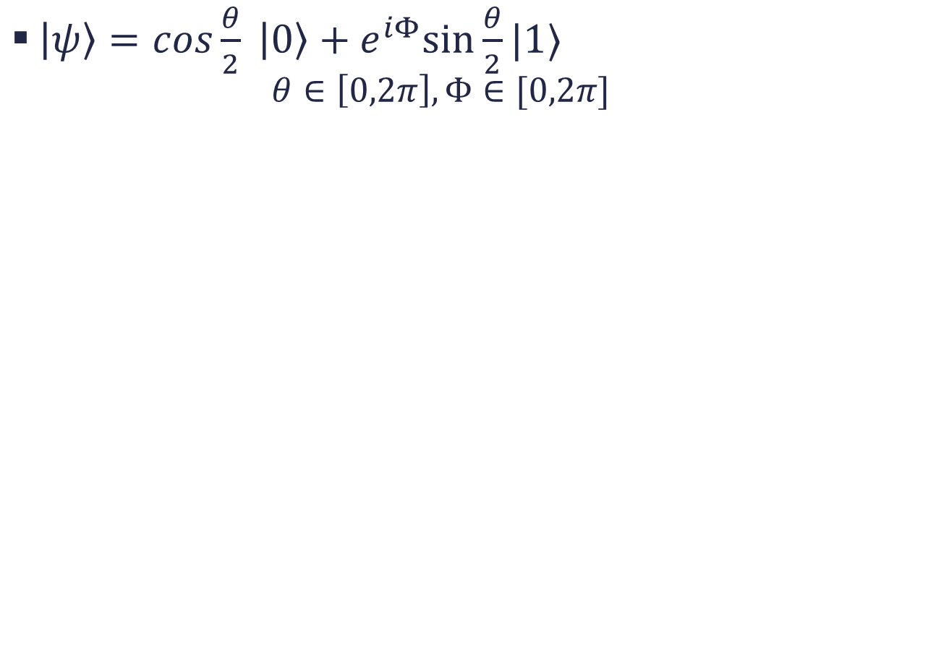
$\left|ψ\right\rangle =cos\frac{θ}{2} \left|0\right\rangle +e^{iΦ}sin⁡\frac{θ}{2}|1⟩$
$$θ∈\left[0,2π\right],Φ∈[0,2π]$$
$$θ$$ | $$Φ$$ | State $|ψ⟩$
0 | $$π$$ | $$|1⟩$$
0 | 0 | $$|0⟩$$
0 | $\frac{π}{2}$ | $$|+⟩$$
$$π$$ | $$\frac{π}{2}$$ | $$|−⟩$$
$$\frac{π}{2}$$ | $$\frac{π}{2}$$ | $$|+i⟩$$
$$\frac{3π}{2}$$ | $$\frac{π}{2}$$ | $$|−i⟩$$

Slide 43
Note that here Points on the sphere are called Pure States (Normalized States). Thus, any points outside the sphere can be brought onto the surface of the spheres by normalizing as Global Phase is not a physical Observable (i.e. we cannot physically distinguish a global phase on measurement). But the Relative Phase is a Physical Observable (i.e. can be distinguished on measurement) and hence represents different State.
Points inside the Sphere represent the “Mixed States” which is a mixture of Pure States.
Prove that the states on the opposite ends of diameter of bloch-sphere are orthonormal!!!

Slide 44
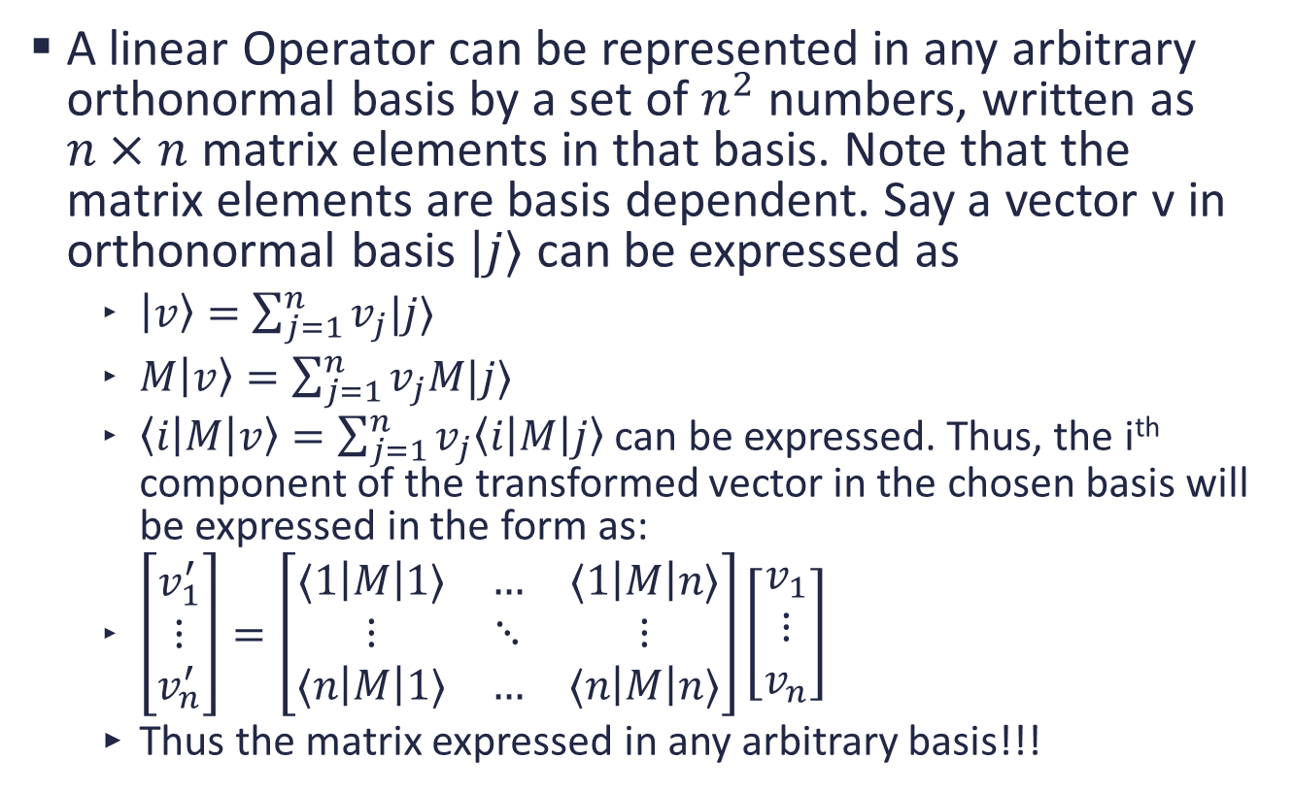
Matrix in a different basis
A linear Operator can be represented in any arbitrary orthonormal basis by a set of $n^{2}$ numbers, written as $n×n$ matrix elements in that basis. Note that the matrix elements are basis dependent. Say a vector v in orthonormal basis $|j⟩$ can be expressed as
$\left|v\right\rangle =\sum_{j=1}^{n}{v_{j}|j⟩}$
$M\left|v\right\rangle =\sum_{j=1}^{n}{v_{j}M|j⟩}$
$\left\langle i\left|M\right|v\right\rangle =\sum_{j=1}^{n}{v_{j}\left\langle i\left|M\right|j\right\rangle }$ can be expressed. Thus, the i^{th} component of the transformed vector in the chosen basis will be expressed in the form as:
$\left[\begin{matrix}v_{1}^{′} \\ ⋮ \\ v_{n}^{′}\end{matrix}\right]=\left[\begin{matrix}⟨1\left|M\right|1⟩ & … & ⟨1\left|M\right|n⟩ \\ ⋮ & ⋱ & ⋮ \\ ⟨n\left|M\right|1⟩ & … & ⟨n\left|M\right|n⟩\end{matrix}\right]\left[\begin{matrix}v_{1} \\ ⋮ \\ v_{n}\end{matrix}\right]$
Thus the matrix expressed in any arbitrary basis!!!

Slide 45
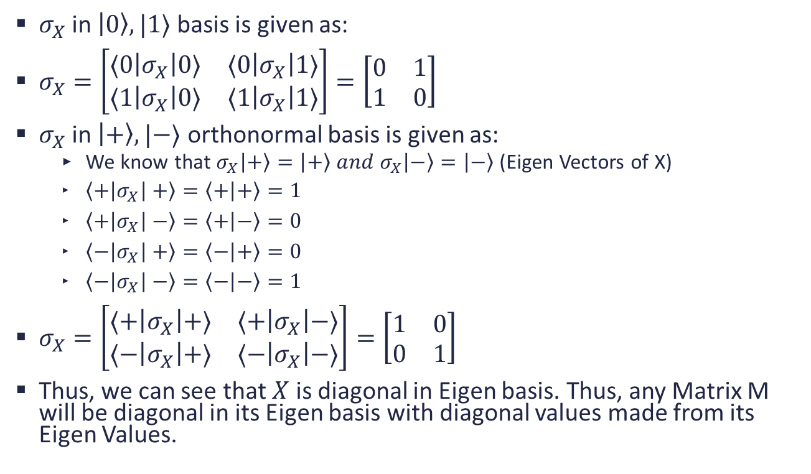
Example
$σ_{X}$ in $\left|0\right\rangle ,|1⟩$ basis is given as:
$σ_{X}=\left[\begin{matrix}⟨0\left|σ_{X}\right|0⟩ & ⟨0\left|σ_{X}\right|1⟩ \\ ⟨1\left|σ_{X}\right|0⟩ & ⟨1\left|σ_{X}\right|1⟩\end{matrix}\right]=\left[\begin{matrix}0 & 1 \\ 1 & 0\end{matrix}\right]$
$σ_{X}$ in $\left|+\right\rangle ,|−⟩$ orthonormal basis is given as:
We know that $σ_{X}\left|+\right\rangle =\left|+\right\rangle and σ_{X}\left|−\right\rangle =\left|−\right\rangle$ (Eigen Vectors of X)
$\left\langle +\left|σ_{X}\right|+\right\rangle =\left\langle + | +\right\rangle =1$
$\left\langle +\left|σ_{X}\right|−\right\rangle =\left\langle + | −\right\rangle =0$
$\left\langle −\left|σ_{X}\right|+\right\rangle =\left\langle − | +\right\rangle =0$
$\left\langle −\left|σ_{X}\right|−\right\rangle =\left\langle − | −\right\rangle =1$
$σ_{X}=\left[\begin{matrix}⟨+\left|σ_{X}\right|+⟩ & ⟨+\left|σ_{X}\right|−⟩ \\ ⟨−\left|σ_{X}\right|+⟩ & ⟨−\left|σ_{X}\right|−⟩\end{matrix}\right]=\left[\begin{matrix}1 & 0 \\ 0 & 1\end{matrix}\right]$
Thus, we can see that $X$ is diagonal in Eigen basis. Thus, any Matrix M will be diagonal in its Eigen basis with diagonal values made from its Eigen Values.

Slide 46
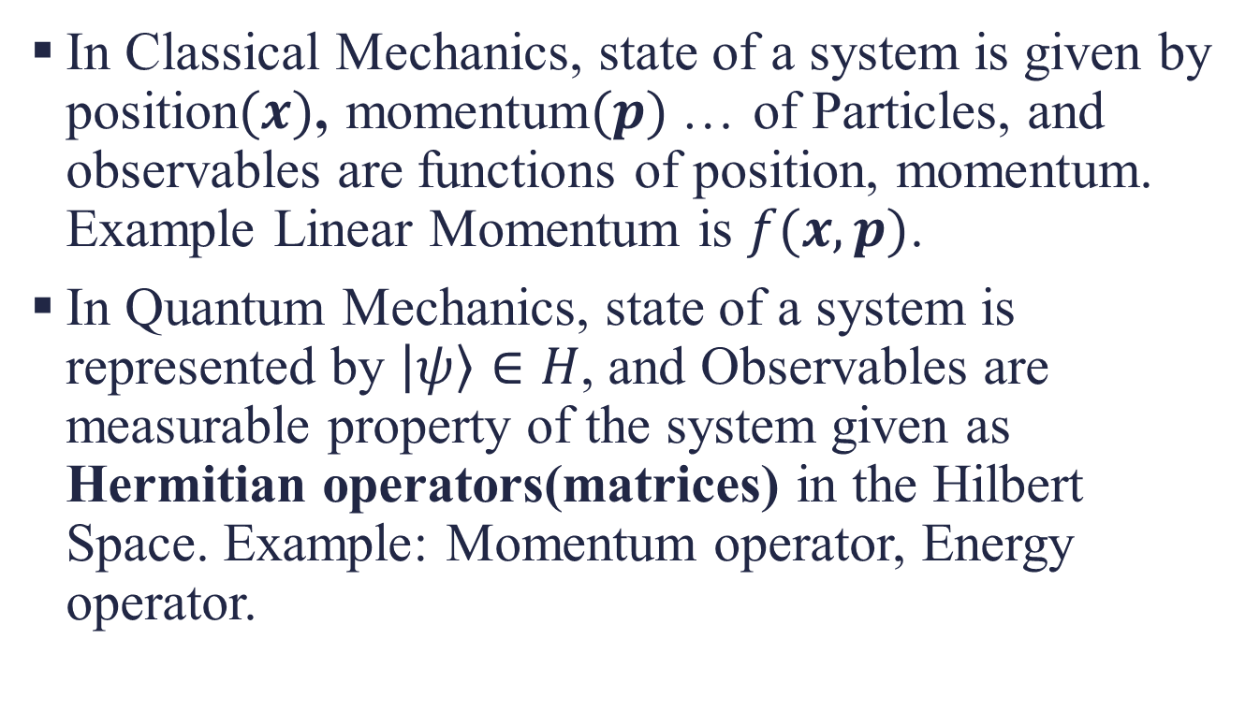
Postulate 2: Observables
In Classical Mechanics, state of a system is given by position$(x)$, momentum$(p)$… of Particles, and observables are functions of position, momentum. Example Linear Momentum is $f(x,p)$.
In Quantum Mechanics, state of a system is represented by $\left|ψ\right\rangle ∈H$, and Observables are measurable property of the system given as Hermitian operators(matrices) in the Hilbert Space. Example: Momentum operator, Energy operator.

Slide 47
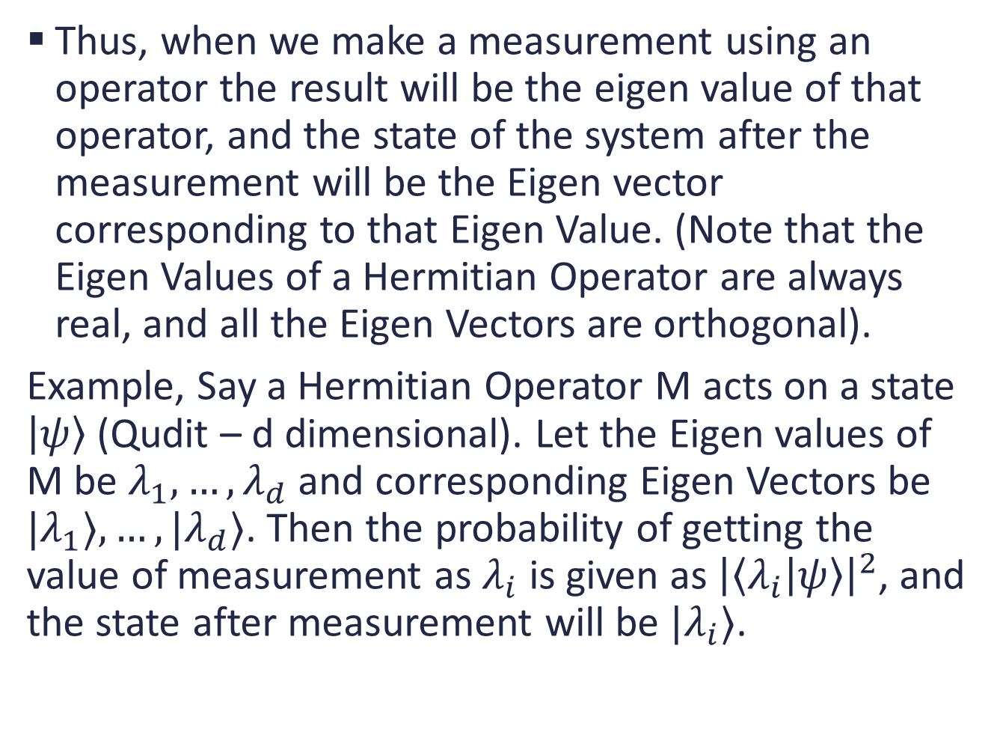
Thus, when we make a measurement using an operator the result will be the eigen value of that operator, and the state of the system after the measurement will be the Eigen vector corresponding to that Eigen Value. (Note that the Eigen Values of a Hermitian Operator are always real, and all the Eigen Vectors are orthogonal).
Example, Say a Hermitian Operator M acts on a state $\left|ψ\right\rangle$ (Qudit – d dimensional). Let the Eigen values of M be $λ_{1},…,λ_{d}$ and corresponding Eigen Vectors be ${|λ}_{1}⟩,…,|λ_{d}⟩$. Then the probability of getting the value of measurement as $λ_{i}$ is given as ${\left|\left\langle λ_{i} | ψ\right\rangle \right|}^{2}$, and the state after measurement will be $|λ_{i}⟩$.

Slide 48
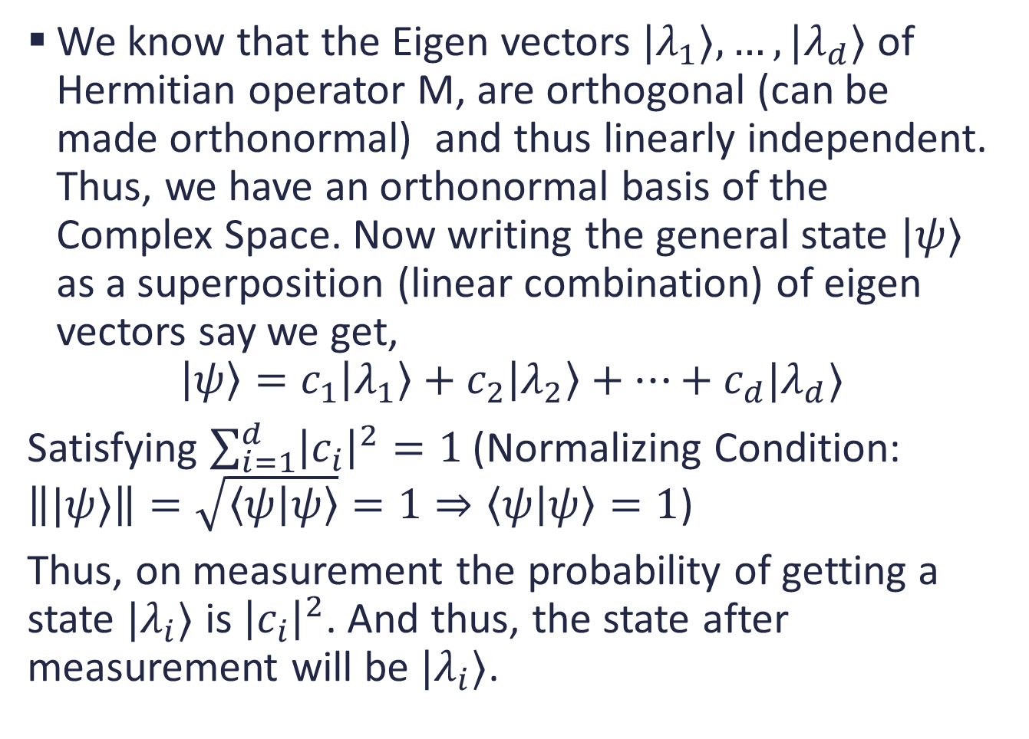
We know that the Eigen vectors $|λ_{1}⟩,…,|λ_{d}⟩$ of Hermitian operator M, are orthogonal (can be made orthonormal) and thus linearly independent. Thus, we have an orthonormal basis of the Complex Space. Now writing the general state $|ψ⟩$ as a superposition (linear combination) of eigen vectors say we get,
$$\left|ψ\right\rangle =c_{1}\left|λ_{1}\right\rangle +c_{2}\left|λ_{2}\right\rangle +…+c_{d}|λ_{d}⟩$$
Satisfying $\sum_{i=1}^{d}{{\left|c_{i}\right|}^{2}}=1$(Normalizing Condition: $\left\||ψ⟩\right\|=\sqrt{\left\langle ψ | ψ\right\rangle }=1⇒\left\langle ψ | ψ\right\rangle =1$)
Thus, on measurement the probability of getting a state $|λ_{i}⟩$ is ${\left|c_{i}\right|}^{2}$. And thus, the state after measurement will be $|λ_{i}⟩$.

Slide 49
Stern-Gerlach Experiment
Stern-Gerlach Experiment (1922)
Silver atoms have one unpaired electron in its outermost shell, which could have spin up or spin down. It is because of this unpaired electron atome which acts as a tiny magnet. (Note atom is neutral as no charge exists so no Lorentz force). A ray of silver atoms is passed through inhomogeneous magnetic field. This makes the unpaired electron align itself parallel or antiparallel to the applied magnetic field.
Expected: since the spins are in random direction the distribution on the photo plate should be random.
Result: The electrons were distributed uniformly at two locations either spin up or spin down.

Slide 50
Explanation: For the paired electrons there is no net resulting force as when they pass through the magnetic field one orients itself parallel and one antiparallel to the magnetic field.
For the unpaired electron it orients itself randomly in either the parallel or antiparallel direction with the magnetic field and thus the Silver atom experiences a net force in either up direction or down direction. Thus, the act of measurement of the spin forces electron to take either up or either down spin orientation and that is measured on the photo plate.

Slide 51
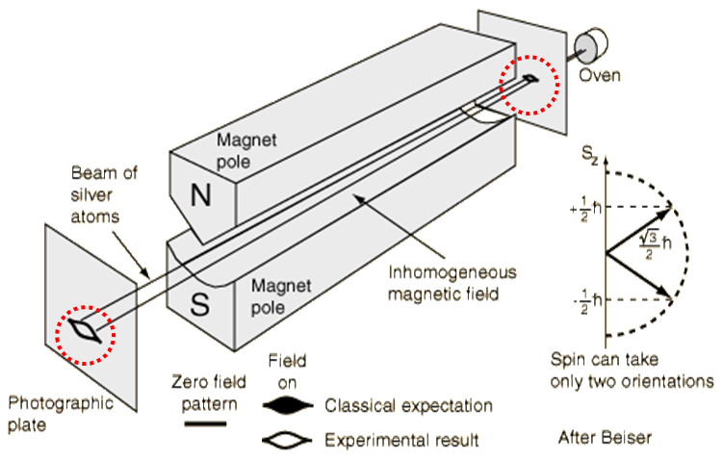

Slide 52
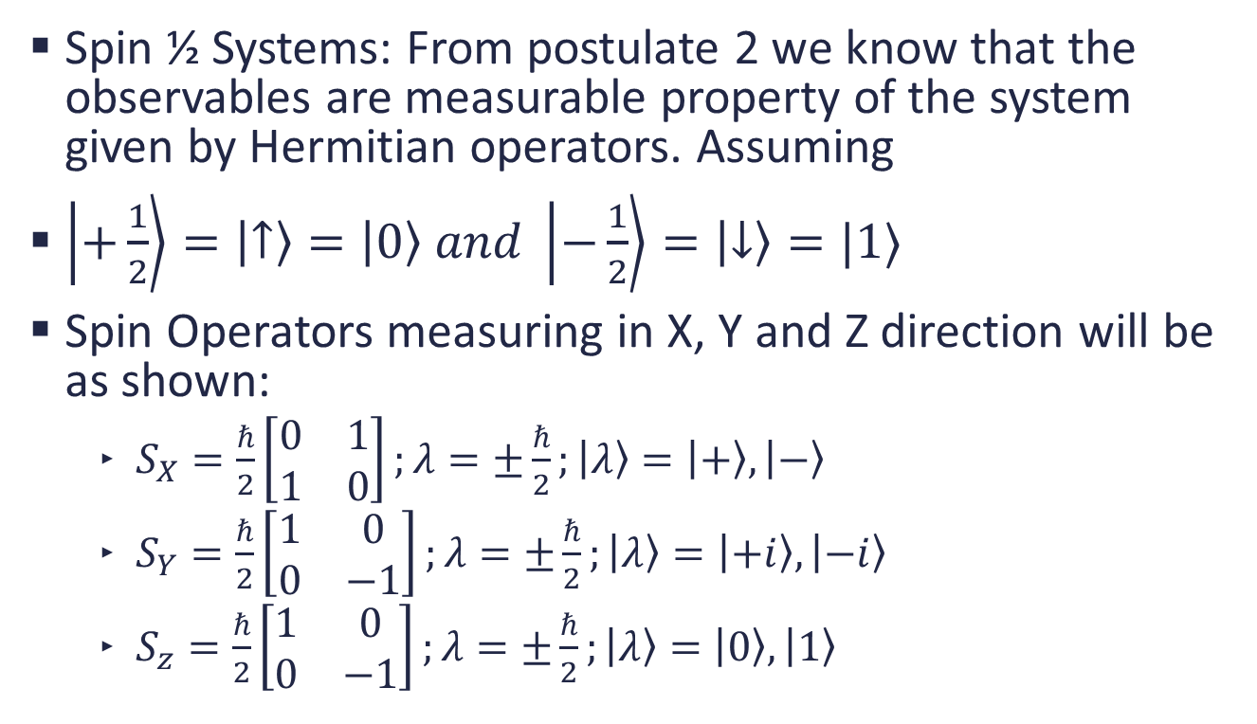
Mathematical Explanation
Spin ½ Systems: From postulate 2 we know that the observables are measurable property of the system given by Hermitian operators. Assuming
$\left|+\frac{1}{2}\right\rangle =\left|↑\right\rangle =\left|0\right\rangle and \left|−\frac{1}{2}\right\rangle =\left|↓\right\rangle =|1⟩$
Spin Operators measuring in X, Y and Z direction will be as shown:
$S_{X}=\frac{ℏ}{2}\left[\begin{matrix}0 & 1 \\ 1 & 0\end{matrix}\right];λ=±\frac{ℏ}{2};\left|λ\right\rangle =\left|+\right\rangle ,\left|−\right\rangle$
$S_{Y}=\frac{ℏ}{2}\left[\begin{matrix}1 & 0 \\ 0 & −1\end{matrix}\right];λ=±\frac{ℏ}{2};\left|λ\right\rangle =\left|+i\right\rangle ,\left|−i\right\rangle$
$S_{z}=\frac{ℏ}{2}\left[\begin{matrix}1 & 0 \\ 0 & −1\end{matrix}\right];λ=±\frac{ℏ}{2};\left|λ\right\rangle =\left|0\right\rangle ,\left|1\right\rangle$

Slide 53
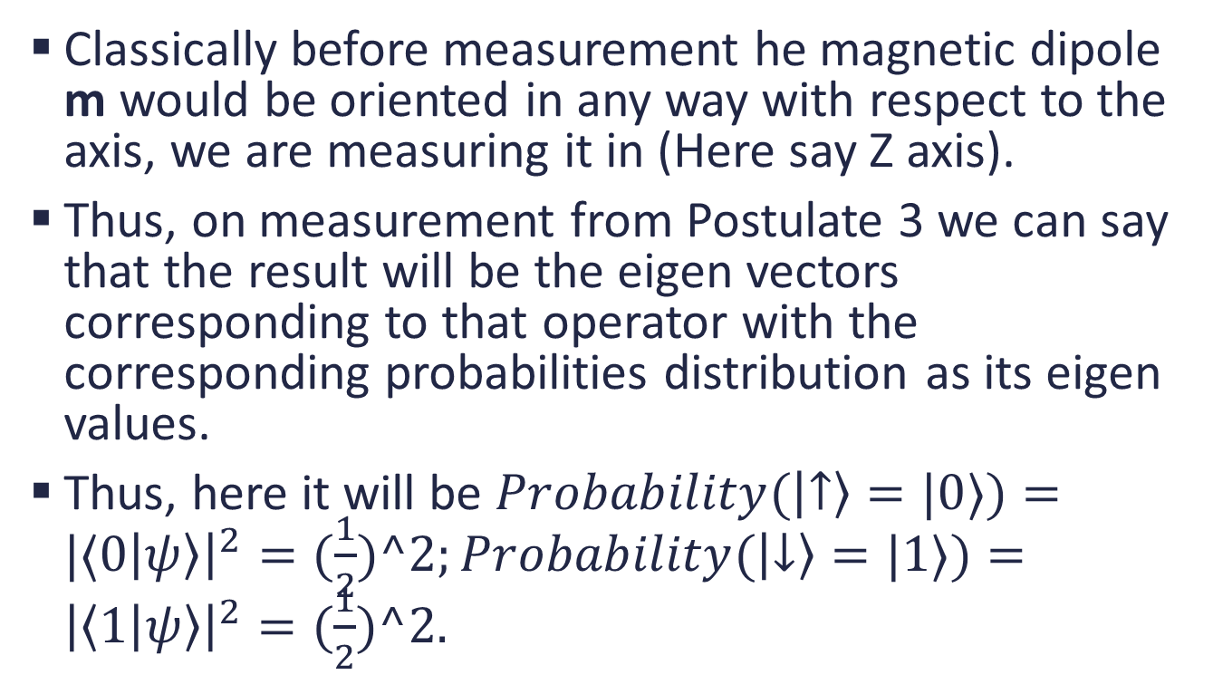
Physical model of Quantum Measurement
Classically before measurement he magnetic dipole m would be oriented in any way with respect to the axis, we are measuring it in (Here say Z axis).
Thus, on measurement from Postulate 3 we can say that the result will be the eigen vectors corresponding to that operator with the corresponding probabilities distribution as its eigen values.
Thus, here it will be $Probability(\left|↑\right\rangle =|0⟩)=|⟨0\left|ψ\right\rangle {\left.​\right|}^{2}=(\frac{1}{2})^2;Probability(\left|↓\right\rangle =|1⟩)={\left|\left\langle 1 | ψ\right\rangle \right|}^{2}=(\frac{1}{2})^2.$

Slide 54
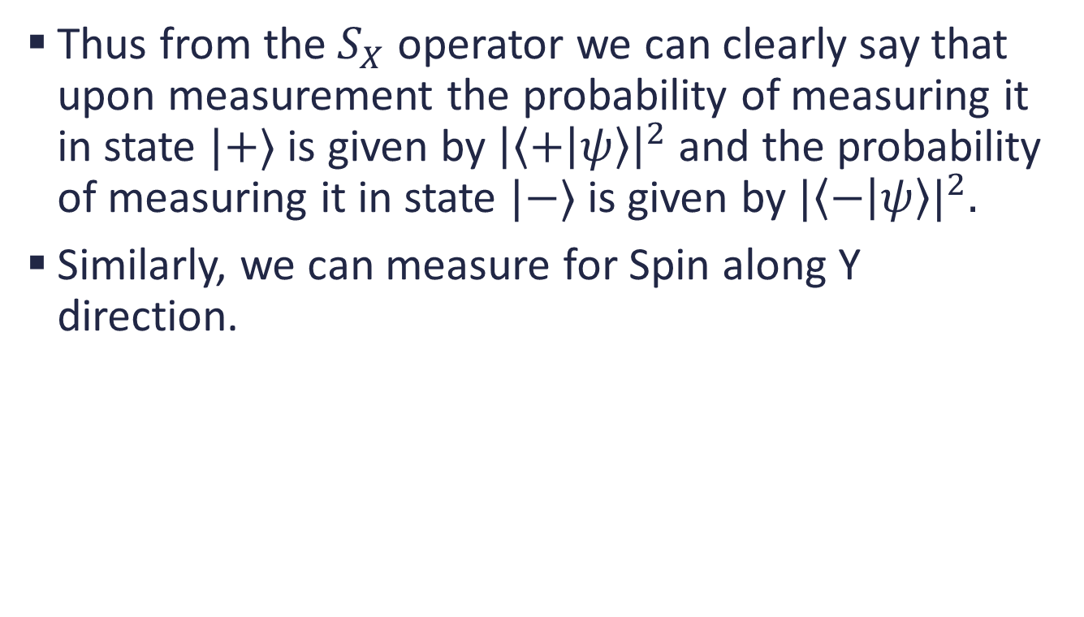
Measurement in X Direction
Thus from the${ S}_{X}$ operator we can clearly say that upon measurement the probability of measuring it in state $|+⟩$ is given by ${\left|\left\langle + | ψ\right\rangle \right|}^{2}$ and the probability of measuring it in state $|−⟩$ is given by $|{\left\langle − | ψ\right\rangle |}^{2}.$
Similarly, we can measure for Spin along Y direction.

Slide 55
















Sequential Stern-Gerlach Experiment
Note that we are assuming that we are measuring in the Eigen states only. Consider the following diagram:
Explanation: Say we measure a random state, say $\left|ψ\right\rangle =|+⟩$ in the Z direction using Spin Operator $S_{Z}$.
$$\frac{1}{2}$$
$$\frac{1}{2}$$
$$\frac{1}{2}$$
$$|ψ⟩$$
$$SG_{Z}$$
$$SG_{X}$$
$$SG_{Z}$$
$$|0⟩$$
$$|+⟩$$
$$|0⟩$$
$$\frac{1}{2}$$
$$|−⟩$$
$$\frac{1}{2}$$
$$\frac{1}{2}$$
$$|1⟩$$
$$|1⟩$$

Slide 56

We have two possibilities either of getting $\left|0\right\rangle or \left|1\right\rangle$ with probabilities ${\left|\left\langle 0 | ψ\right\rangle \right|}^{2}={\left|\frac{1}{\sqrt{2}}\right|}^{2}=\frac{1}{2} and {\left|\left\langle 1 | ψ\right\rangle \right|}^{2}={\left|\frac{1}{\sqrt{2}}\right|}^{2}=\frac{1}{2}$ respectively which are the corresponding Eigen values and eigen vectors of the Spin operator $S_{Z}$ respectively, remember here $\left|ψ\right\rangle =\left|+\right\rangle =\frac{1}{\sqrt{2}}\left|0\right\rangle +\frac{1}{\sqrt{2}}|1⟩$.
Suppose we get $|0⟩$ and now we measure Spin in X Direction, note that we can write $\left|0\right\rangle =\frac{1}{\sqrt{2}}\left|+\right\rangle +\frac{1}{\sqrt{2}}|−⟩$.
Upon measurement of Spin in X direction both $\left|+\right\rangle and |−⟩$ are equally likely with probabilities $\frac{1}{2}$ each. Thus, say upon measuring we get $|+⟩$ state. Now we again measure the Spin in the Z direction.
Classically we may think that since the spin before was $\left|0\right\rangle$, hence must be the same here. But Qunatmly, the spin here is again in a superposition state of $\left|0\right\rangle and |1⟩$ with equally likely probabilities being $\frac{1}{2}$ each.
Uncertainity Principle: $σ_{X} and σ_{Z}$ are incompatible observables, thus cannot be measured simultaneously.

Slide 57

Superconducting Qubits
Another form of visualizing a Qubit State Space. Imagine an atom with one electron in the outer most shell
Now let it be in the lowest possible energy state i.e. ground state.
On measurement i.e. shining light we force the electron to either be in the ground state $\left|g\right\rangle =\left|0\right\rangle$ or the excited state $\left|e\right\rangle =\left|1\right\rangle$
Note that it is also possible to make it a multi-level quantunisation of energy into different excited energy states. Thus making it behave as a Qutrit (3 level Quantum System) or a Qudit (d-level Quantum Systems).

Slide 58
Measurements
There are three ways to make a measurement

Slide 59

Postulate 3: Time Evolution
How does state $\left|ψ\right\rangle$ of a Quantum System changes with time: Evolution of a closed system is described by a Unitary Transformation. (Note that a Unitary transformation corresponds to a Unitary Matrix $\left(UU^{†}=I=U^{†}U\right)$ which preserves norm, thus the state of qubit after its action will be a new normalized quantum state.)
The time evolution of the state of a closed quantum system is described by Schrodinger Eequation
$$iℏ=\frac{∂\left|ψ\right\rangle }{∂t}=H|ψ⟩$$
Here H is a Hermitian operator (Hamiltonian of Closed System) and $ℏ$ is Planck's constant.

Slide 60
Eigen Value Problem
Eigen value equation: An operator acting on a ket leaves it invariant up to an overall phase (scalar) is an eigen value problem.

Slide 61

Solution to Schrodinger Equation
$\left|ψ\left(t\right)\right\rangle =e^{−\frac{iHt}{ℏ}}\left|ψ\left(0\right)\right\rangle$ is the solution to the Schrodinger Equation.
$\left|ψ\left(t_{2}\right)\right\rangle =e^{−\frac{iH\left(t_{2}−t_{1}\right)}{ℏ}}\left|ψ\left(t_{1}\right)\right\rangle =U\left(t_{1},t_{2}\right)\left|ψ\left(t_{1}\right)\right\rangle$ Thus, $U\left(t_{1},t_{2}\right)=e^{−\frac{iH\left(t_{2}−t_{1}\right)}{ℏ}}$
Clearly, $U\left(t_{1},t_{2}\right)U\left(t_{0},t_{1}\right)=U(t_{2},t_{0})$ which can be verified by substituting in the above equation.
Also note that for unitary operators $U^{†}=U^{−1}$.

Slide 62

Quantum Gates (for single qubit)
Gates are transformations on 2D Complex Vectors (State Vector).
Pauli Operators ($σ_{I},σ_{X},σ_{Y},σ_{Z})$
Hadamard Operator $(H)$
Phase Operations${(P}_{θ})$
All the Quantum Gates are Unitary (hence reversible i.e. for a given output we can determine which input was given).
Except for Rotation Matrices (phase operations), both Pauli and Hadamard operators are Hermitian in addition to being unitary.
Thus, for a Hermitian Unitary Matrix M it implies that
$$M=M^{†}=M^{−1}$$

Slide 63



Pauli Operators – Identity Gate
$$I$$
Used for the measurement of decoherence(Qubits starts to lose its Quantum abilities after certain amount of time.
$σ_{I}=I=\left[\begin{matrix}1 & 0 \\ 0 & 1\end{matrix}\right];λ=1,1;\left|λ\right\rangle =\{|0⟩,|1⟩\}$
Returns the same output as input.
$I\left|0\right\rangle =\left|0\right\rangle \left[\begin{matrix}1 & 0 \\ 0 & 1\end{matrix}\right]\left[\begin{matrix}1 \\ 0\end{matrix}\right]=\left[\begin{matrix}1 \\ 0\end{matrix}\right]$
$I\left|1\right\rangle =\left|1\right\rangle \left[\begin{matrix}1 & 0 \\ 0 & 1\end{matrix}\right]\left[\begin{matrix}0 \\ 1\end{matrix}\right]=\left[\begin{matrix}0 \\ 1\end{matrix}\right]$
$σ_{I}=I=|0⟩⟨0|+|1⟩⟨1|$ (as an outer product).
Truth Table
Input | Output
$$|0⟩$$ | $$|0⟩$$
$$|1⟩$$ | $$|1⟩$$

Slide 64



Pauli Operators – X Gate
$$X$$
Classical NOT Gate: does $π$ rotation about X axis on Bloch Sphere. Bit Flip Gate
$σ_{X}=X=\left[\begin{matrix}0 & 1 \\ 1 & 0\end{matrix}\right];λ=±1;\left|λ\right\rangle =\{|+⟩,|−⟩\}$
$X\left|0\right\rangle =\left|1\right\rangle \left[\begin{matrix}0 & 1 \\ 1 & 0\end{matrix}\right]\left[\begin{matrix}1 \\ 0\end{matrix}\right]=\left[\begin{matrix}0 \\ 1\end{matrix}\right]$
$X\left|1\right\rangle =\left|0\right\rangle \left[\begin{matrix}0 & 1 \\ 1 & 0\end{matrix}\right]\left[\begin{matrix}0 \\ 1\end{matrix}\right]=\left[\begin{matrix}1 \\ 0\end{matrix}\right]$
$σ_{X}=X=|1⟩⟨0|+|0⟩⟨1|$ (as an outer product).
Truth Table
Input | Output
$$|0⟩$$ | $$|1⟩$$
$$|1⟩$$ | $$|0⟩$$

Slide 65



Pauli Operators – Y Gate
$$Y$$
Classical NOT Gate: does $π$ rotation about Y axis on Bloch Sphere.
$σ_{Y}=Y=\left[\begin{matrix}0 & −i \\ i & 0\end{matrix}\right];λ=±1;\left|λ\right\rangle =\{|+i⟩,|−i⟩\}$
$Y\left|0\right\rangle =i\left|1\right\rangle \left[\begin{matrix}0 & −i \\ i & 0\end{matrix}\right]\left[\begin{matrix}1 \\ 0\end{matrix}\right]=i\left[\begin{matrix}0 \\ 1\end{matrix}\right]$
$Y\left|1\right\rangle =−i\left|0\right\rangle \left[\begin{matrix}0 & −i \\ i & 0\end{matrix}\right]\left[\begin{matrix}0 \\ 1\end{matrix}\right]=−i\left[\begin{matrix}1 \\ 0\end{matrix}\right]$
$σ_{Y}=Y=i|1⟩⟨0|−i|0⟩⟨1|$ (as an outer product).
$σ_{Y}=iσ_{X}σ_{Z}$
Truth Table
Input | Output
$$|0⟩$$ | $$i|1⟩$$
$$|1⟩$$ | $$−i|0⟩$$

Slide 66



Pauli Operators – Z Gate
$$Z$$
Classical NOT Gate: does $π$ rotation about Z axis on Bloch Sphere. Phase Flip/Phase Shift Gate.
$σ_{Z}=Z=\left[\begin{matrix}1 & 0 \\ 0 & −1\end{matrix}\right];λ=±1;\left|λ\right\rangle =\{|0⟩,|1⟩\}$
$Z\left|0\right\rangle =\left|0\right\rangle \left[\begin{matrix}1 & 0 \\ 0 & −1\end{matrix}\right]\left[\begin{matrix}1 \\ 0\end{matrix}\right]=\left[\begin{matrix}1 \\ 0\end{matrix}\right]$
$Z\left|1\right\rangle =−\left|1\right\rangle \left[\begin{matrix}1 & 0 \\ 0 & −1\end{matrix}\right]\left[\begin{matrix}0 \\ 1\end{matrix}\right]=−\left[\begin{matrix}0 \\ 1\end{matrix}\right]$
$σ_{Z}=Z=|0⟩⟨0|−|1⟩⟨1|$ (as an outer product).
$Z\left|j\right\rangle ={\left(−1\right)}^{j}\left|j\right\rangle j∈\{0,1\}$
Truth Table
Input | Output
$$|0⟩$$ | $$|0⟩$$
$$|1⟩$$ | $$−|1⟩$$

Slide 67



Hadamard Gate– H Gate
$$H$$
Creates a superposition of Qubits $\left|0\right\rangle and \left|1\right\rangle$.Basis Transformation.
Rotates by $\frac{π}{2}$ about each Z and X Axis thus, a total rotation of $π$.
$Z=\frac{1}{\sqrt{2}}\left[\begin{matrix}1 & 1 \\ 1 & −1\end{matrix}\right];λ=±1;\left|λ\right\rangle =\{|0⟩,|1⟩\}$
$H\left|0\right\rangle =\left|+\right\rangle \frac{1}{\sqrt{2}}\left[\begin{matrix}1 & 1 \\ 1 & −1\end{matrix}\right]\left[\begin{matrix}1 \\ 0\end{matrix}\right]=\frac{1}{\sqrt{2}}\left[\begin{matrix}1 \\ 1\end{matrix}\right]$
$H\left|1\right\rangle =\left|−\right\rangle \frac{1}{\sqrt{2}}\left[\begin{matrix}1 & 1 \\ 1 & −1\end{matrix}\right]\left[\begin{matrix}0 \\ 1\end{matrix}\right]=\frac{1}{\sqrt{2}} \left[\begin{matrix}1 \\ −1\end{matrix}\right]$
$H=|+⟩⟨0|+|−⟩⟨1|$ (as an outer product).
$=\frac{1}{\sqrt{2}}(|0⟩⟨0|+|1⟩⟨0|+|0⟩⟨1|−\left|1\right\rangle \left\langle 1\right|)$
Truth Table
Input | Output
$$|0⟩$$ | $$|+⟩$$
$$|1⟩$$ | $$|−⟩$$

Slide 68



Rotation Matrices $P_{θ}^{Z}$
$$P_{θ}^{Z}$$
Rotates by $θ$ around Z Axis of Bloch Sphere.
$P_{θ}^{Z}=\left[\begin{matrix}1 & 0 \\ 0 & e^{iθ}\end{matrix}\right]$
$P_{θ}^{Z}=\operatorname{Icos}{\frac{θ}{2} −iσ_{Z}cos{\frac{θ}{2}} }$
Special Case: $T (θ=\frac{π}{8})and T^{†}(θ=−\frac{π}{8})$ $T=\left[\begin{matrix}1 & 0 \\ 0 & e^{\frac{iπ}{8}}\end{matrix}\right]⇒T^{†}=\left[\begin{matrix}1 & 0 \\ 0 & e^{−\frac{iπ}{8}}\end{matrix}\right]$
Special Case: $S \left(θ=\frac{π}{2}\right)and S^{†} \left(θ=−\frac{π}{2}\right)S=\left[\begin{matrix}1 & 0 \\ 0 & i\end{matrix}\right]⇒S^{†}=\left[\begin{matrix}1 & 0 \\ 0 & −i\end{matrix}\right].$
Note that $S=T^{2}$. Note that S and T are unitary but not Hermitian matrix.
Note that ${\left(HSH\right)}^{2}=X$(square root of NOT Gate) – departure from Classical Gates.

Slide 69



Rotation Matrices $P_{θ}^{X}$
$$P_{θ}^{X}$$
Rotates by $θ$ around X Axis of Bloch Sphere.
$P_{θ}^{Z}=\left[\begin{matrix}\cos{\frac{θ}{2}} & −i\sin{\frac{θ}{2}} \\ \sin{\frac{θ}{2}} & \cos{\frac{θ}{2}}\end{matrix}\right]$
$P_{θ}^{Z}=\operatorname{Icos}{\frac{θ}{2} −iσ_{X}cos{\frac{θ}{2}} }$

Slide 70



Rotation Matrices $P_{θ}^{Y}$
$$P_{θ}^{Y}$$
Rotates by $θ$ around Y Axis of Bloch Sphere.
$P_{θ}^{Z}=\left[\begin{matrix}\cos{\frac{θ}{2}} & −\sin{\frac{θ}{2}} \\ \sin{\frac{θ}{2}} & \cos{\frac{θ}{2}}\end{matrix}\right]$
$P_{θ}^{Z}=\operatorname{Icos}{\frac{θ}{2} −iσ_{Y}cos{\frac{θ}{2}} }$

Slide 71

Universal Quantum Gates
To construct a single Qubit Logic Gate
$U=\left[\begin{matrix}\cos{\frac{θ}{2}} & {−e}^{iγ}\sin{\frac{θ}{2}} \\ e^{iφ}\sin{\frac{θ}{2}} & e^{i(φ+γ)}\cos{\frac{θ}{2}}\end{matrix}\right]$
Where $0≤θ≤π;0≤φ≤2π;0≤γ≤2π$ are rotations around x, y and z axis respectively.

Slide 72
Multiple-Qubit Systems
What if more than one Quantum Systems are combined?

Slide 73

Multiple Quantum Systems
In Classical Physics the possible states of a system on n objects, whose individual states are described by a two- dimensional vector space, can be described by a vector space of 2n dimensions.
Example: Say to describe State of a classical system of n particles we require to know position and momentum of each particle, thus 2n dimensions. Thus the size of the space grows linearly with the number of objects.
In Quantum Mechanics, the combined state space of n quantum systems, each with states modelled by a two- dimensional vector space results in a vector space of $2^{n}$ dimensions. (combined using Tensor product)
For Example, Say to describe n quantum systems we are required to know the complex coefficient of each of the possible combination the quantum system could be in. Thus the size of the space grows exponentially with the number of objects.

Slide 74

Tensor Product of Vector Spaces
Tensor product $V⊗W$ of two vector spaces with bases $A=\{|α_{1}⟩,\left|α_{2}\right\rangle ,…,|α_{n}⟩\}$ and $B=\{|β_{1}⟩,|β_{2}⟩,…,|β_{m}⟩\}$ respectively is a nm dimensional vector space with a basis consisting of nm elements of the form $|α_{i}⟩⊗|β_{j}⟩$ where $⊗$ is the tensor product.
This is used to represent a multi qubit Quantum System. Tensor product of a $m×n$ matrix with $p×q$ matrix is a $mp×nq$ matrix.

Slide 75

Examples
Say for a two-qubit system with basis states, $\left\{\left|0\right\rangle ,\left|1\right\rangle \right\},\{\left|0\right\rangle ,\left|1\right\rangle \}$. The four basis states of the two-qubit system using tensor product (Kronecker product).
$\left|0\right\rangle ⊗\left|0\right\rangle =\left|00\right\rangle =\left[\begin{matrix}1 \\ 0\end{matrix}\right]⊗\left[\begin{matrix}1 \\ 0\end{matrix}\right]=\left[\begin{matrix}1 \\ 0 \\ \begin{aligned}0 \\ 0\end{aligned}\end{matrix}\right]$
$\left|0\right\rangle ⊗\left|1\right\rangle =\left|01\right\rangle =\left[\begin{matrix}1 \\ 0\end{matrix}\right]⊗\left[\begin{matrix}0 \\ 1\end{matrix}\right]=\left[\begin{matrix}0 \\ 1 \\ \begin{aligned}0 \\ 0\end{aligned}\end{matrix}\right]$
$\left|1\right\rangle ⊗\left|0\right\rangle =\left|10\right\rangle =\left[\begin{matrix}0 \\ 1\end{matrix}\right]⊗\left[\begin{matrix}1 \\ 0\end{matrix}\right]=\left[\begin{matrix}0 \\ 0 \\ \begin{aligned}1 \\ 0\end{aligned}\end{matrix}\right]$

Slide 76

Examples
$\left|1\right\rangle ⊗\left|1\right\rangle =\left|11\right\rangle =\left[\begin{matrix}0 \\ 1\end{matrix}\right]⊗\left[\begin{matrix}0 \\ 1\end{matrix}\right]=\left[\begin{matrix}0 \\ 0 \\ \begin{aligned}0 \\ 1\end{aligned}\end{matrix}\right]$
Thus, the basis state of a two quit Quantum System will be as shown above.
$\left|ψ\right\rangle =α_{00}\left|00\right\rangle +α_{01}\left|01\right\rangle +α_{10}\left|10\right\rangle +α_{11}|11⟩$
Thus, it requires 2² amplitudes to uniquely determine the state.
Similarly, for a 3 qubit quantum system:
$\left|1\right\rangle ⊗\left|0\right\rangle ⊗\left|0\right\rangle =\left[\begin{matrix}0 \\ 1\end{matrix}\right]⊗\left[\begin{matrix}1 \\ 0\end{matrix}\right]⊗\left[\begin{matrix}1 \\ 0\end{matrix}\right]=\left[\begin{matrix}0 \\ 0 \\ \begin{aligned}0 \\ 0 \\ 1 \\ 0 \\ 0 \\ 0\end{aligned}\end{matrix}\right]$
Hence, we can clearly conclude that a n qubit quantum system will require 2^{n} amplitudes i.e. 2^{n} dimensional complex vector space.

Slide 77

In case of multiple qubit Quantum Systems, they do not behave necessarily independently but there could be a correlation between them. For example, Entanglement.
Consider two two-level (Qubit) Quantum Systems X and Y, then what are the quantum states (basis) for this new system XY. (treated as a single system)
They are given by the tensor product of the basis states of the system XY which was shown earlier $\{\left|00\right\rangle ,\left|01\right\rangle ,\left|10\right\rangle ,|11⟩\}$. Thus, any state of the multi-Qubit two level quantum system can be written as:
$\left|ψ\right\rangle =α_{00}\left|00\right\rangle +α_{01}\left|01\right\rangle +α_{10}\left|10\right\rangle +α_{11}|11⟩$

Slide 78

Now we may be able to factorize these states into individual qubit tensor product. Thus, knowing a state of the individual qubits of the quantum system provided the state of the combined system is known.
For Example, $\left|ψ\right\rangle =\frac{1}{6}\left|00\right\rangle +\frac{1}{12}\left|01\right\rangle +\frac{1}{2}\left|10\right\rangle +\frac{1}{4}\left|11\right\rangle$ for the combined system can be written as
$\left|φ\right\rangle =\frac{1}{4}\left|0\right\rangle +\frac{3}{4}\left|1\right\rangle and \left|γ\right\rangle =\frac{2}{3}\left|0\right\rangle +\frac{1}{3}|1⟩$, simply by solving system of linear equations.
What about the state $\left|ψ\right\rangle =\frac{1}{2}\left|00\right\rangle +\frac{1}{2}|11⟩$. The equations would be:
$φ_{0}γ_{0}=\frac{1}{2};φ_{0}γ_{1}=0;φ_{1}γ_{0}=0;φ_{1}γ_{1}=\frac{1}{2}$
Clearly this equation has no solution. This phenomenon is called entanglement.

Slide 79

Properties of Tensor Product
The tensor product of two vectors in multilinear
Linearity in the first argument:
$(\left|φ_{1}\right\rangle +|φ_{2}⟩)⊗|ψ⟩=(|φ_{1}⟩⊗|ψ⟩)+(|φ_{2}⟩⊗|ψ⟩)$
$(α|φ⟩)⊗|ψ⟩=α(|φ⟩⊗|ψ⟩)$
Linearity in the second argument:
$|ψ⟩⊗(\left|φ_{1}\right\rangle +|φ_{2}⟩) =(|ψ⟩⊗|φ_{1}⟩)+(|ψ⟩⊗|φ_{2}⟩)$
$|ψ⟩⊗(α|φ⟩) =α(|ψ⟩⊗|φ⟩)$
Generalization to three or more systems+
$\left|φ_{1}\right\rangle ⊗\left|φ_{2}\right\rangle …\left|φ_{n}\right\rangle =(|φ_{1}⟩⊗\left|φ_{2}\right\rangle …|φ_{n−1}⟩)⊗|φ_{n}⟩$

Slide 80
Measurements of Multiple Systems
Measurements of the compound system work in the same way as measurements of single systems – provided that all of the systems are measured.

Slide 81
Abbreviations
A shortened form of a word or phrase

Slide 82
Abbreviations
ITP – Imaginary Time Propagation Method

Slide 83
References
Works Cited

Slide 84
References
[1]L. Lehtovaara, J. Toivanen, and J. Eloranta. 2007. Solution of time-independent Schrödinger equation by the imaginary time propagation method. Journal of Computational Physics 221, 1 (2007), 148–157. DOI:https://doi.org/https://doi.org/10.1016/j.jcp.2006.06.006

Slide 85
Thank You!
Nihar Shah
Matrix Lab
Guide: Prof. Phani Motamarri

